Slide 1
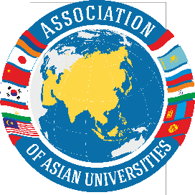

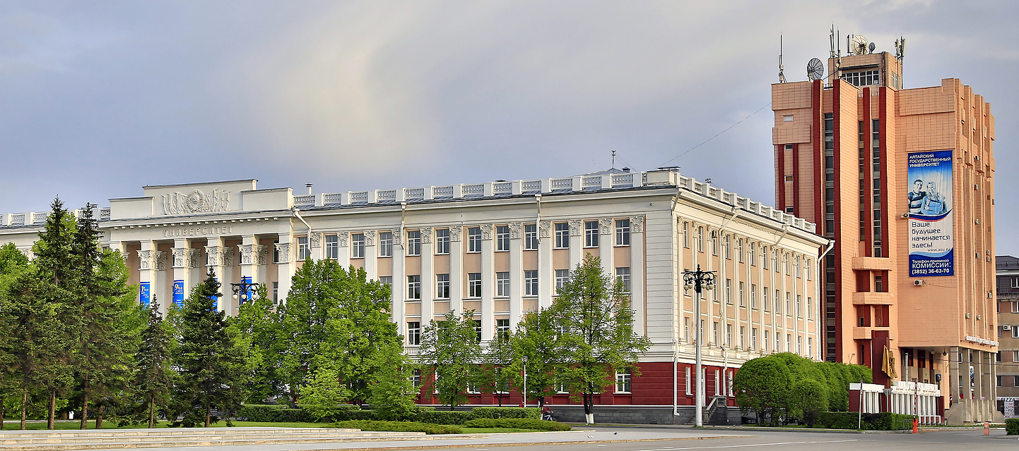
Altai State University –
the flagship university of the Altai Region

Slide 2
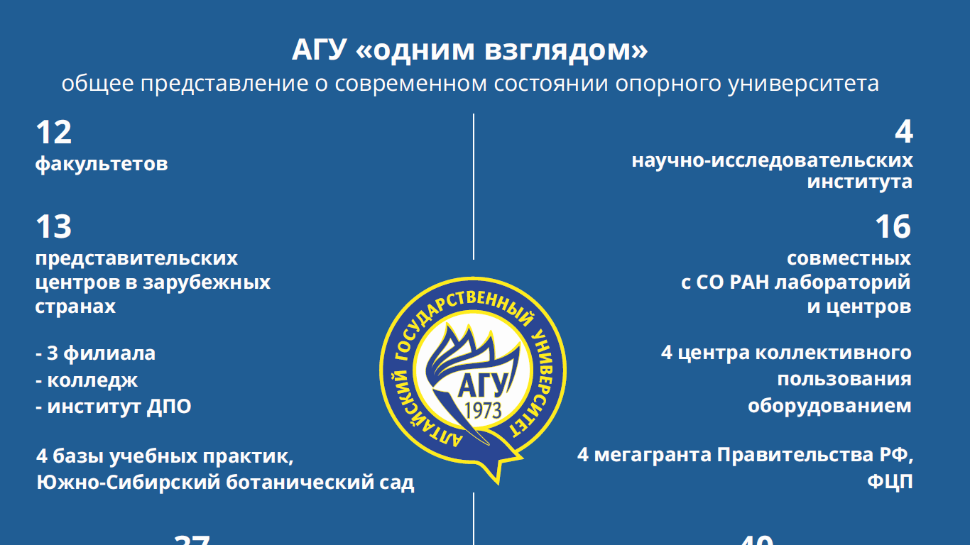
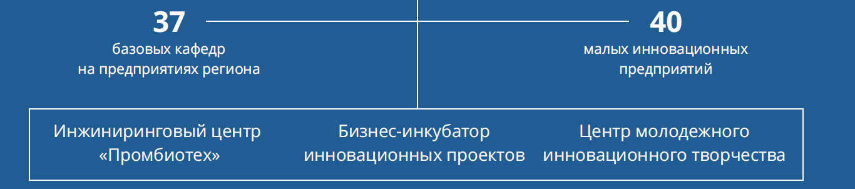
ASU at a glance
a general idea of the current state of the flagship university
12 faculties
13 representative centers in foreign countries
- 3 branches
- college
- institute of additional vocational education
4 bases of educational practices, South-Siberian Botanical Garden
4 research institutes
16 joint laboratories and centers with the Siberian Branch of
the Russian Academy of Science
4 centers for shared use of equipment
4 megaprojects supported
by the Government
of the Russian Federation
basic departments
at the enterprises of the region
small innovative
companies
Engineering center "Prombiotech" | Business incubator of innovative projects | Center for Youth Innovations

Slide 3
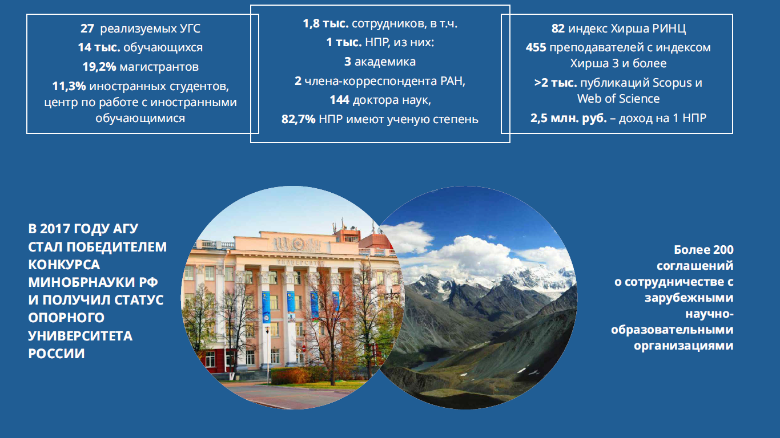
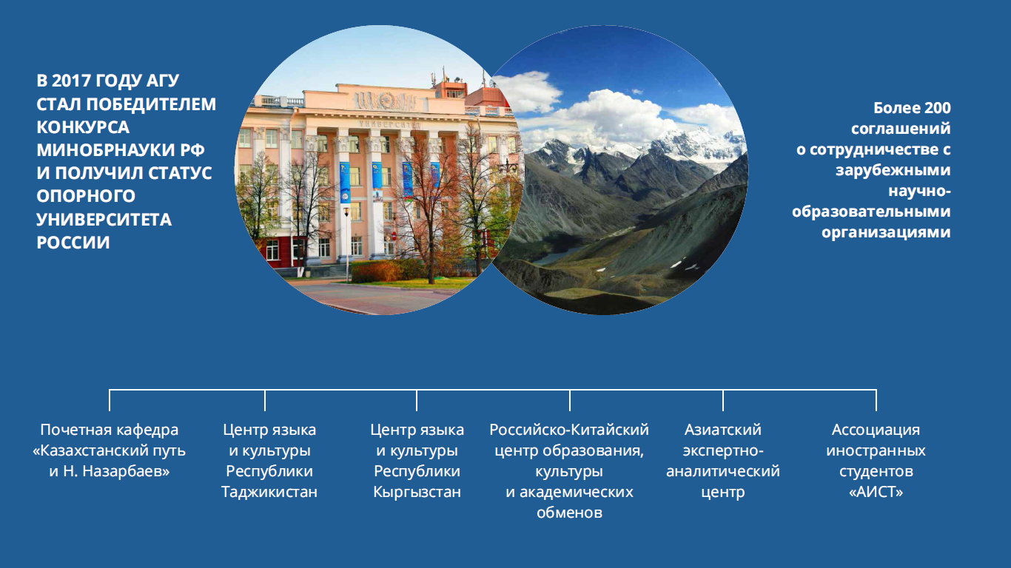
1,8 thousand employees, incl.
1 thousand scientific and pedagogical staff, including:
3 academicians
2 corresponding members of the Russian Academy of Sciences,
144 Doctors of Sciences,
82.7% have a degree
27 implemented enlarged groups of specialties
14 thousand of students
19.2% of Master’s degree students
11.3% of international students,
international students center
82 H-index (Russian Science Citation Index)
> 2 thousand publications indexed in Web of Science and Scopus
2.5 million rubles. – Income per 1 employee
IN 2017 ASU
BECAME THE WINNER
OF CONTEST OF
MINISTRY OF EDUCATION AND SCIENCE OF THE RUSSIAN FEDERATION
AND HAS RECEIVED THE STATUS
OF FLAGSHIP
UNIVERSITY
OF RUSSIA
More than 200
agreements
on cooperation with
foreign
scientific and
educational
organizations
Honorary department “The Kazahstan way Named after N.Nazarbayev” | Center of Language and Culture of the Republic of Tajikistan | Center of Language and Culture of the Republic of Kyrgyzstan | Russian-Chinese Center of Education, Culture and Academic Exchanges | Asian Expert and Analytical Centre | Association of International Students “AIST”

Slide 4
COMPETITIVE ADVANTAGES OF THE ALTAI STATE UNIVERSITY
The unique geographical location of the Altai Territory in the center of Eurasia, at the junction of the borders of Kazakhstan, China, Mongolia and Russia in direct contact with the historically close to Russia countries of Central Asia.
The largest integration center in the scientific and educational space of Central Asia, holding a leading position in the export of education, development and transfer of the best educational practices, advanced scientific developments and expert-analytical potential.
Leading center for promoting the Russian language, culture and education in the Central Asian Macroregion.

Slide 5
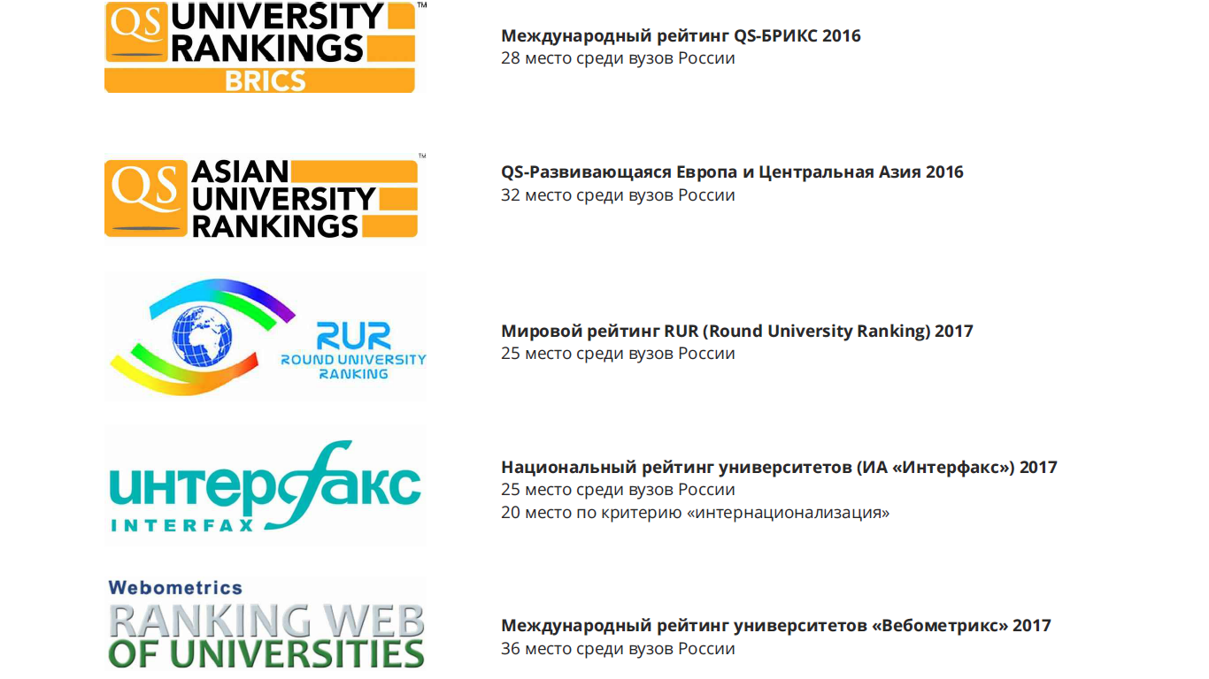
ASU positions in International Rankings
World Ranking RUR (Round University Ranking) 2017
25 place among the universities of Russia
International rating of QS-BRICS 2016
28 place among the universities of Russia
QS-Development Europe and Central Asia 2016
32 place among the universities of Russia
National University Ranking (IA "Interfax") 2017
25 place among the universities of Russia
20 place on the criterion of "internationalization"
International rating of universities "Vebometriks" 2017
36 place among Russian universities

Slide 6

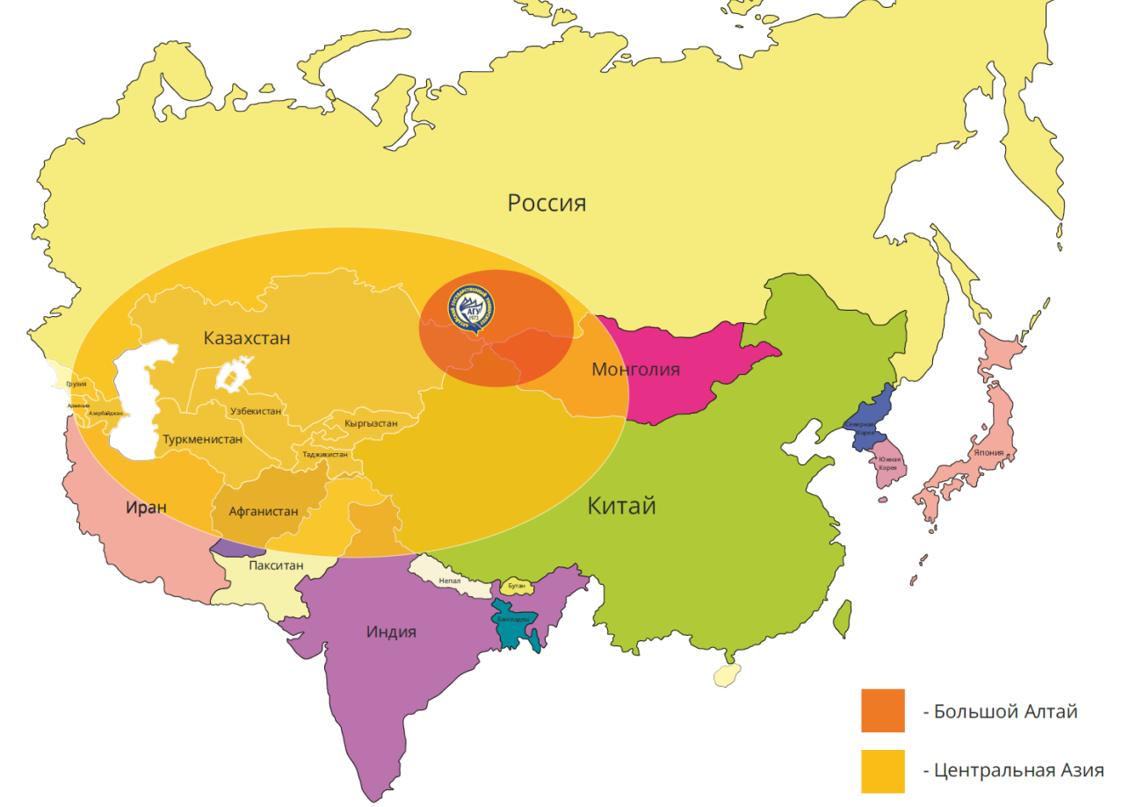





The resource-expert center in Central Asia
INTERNATIONALIZATION OF EDUCATION AND ACADEMIC EXCHANGE
11.3% of international students.
30 joint educational programs
International internships and specialized summer schools
Russia
NETWORK COOPERATION
Association of Asian Universities
(42 universities from 8 countries)
University of SCO (base university in 4 directions)
International scientific projects in the field of archeology and ethnography, biomedicine and biotechnology, astrophysics, rational nature management and zoosystematics
China
EXPERT-ANALYTICAL ACTIVITY
Asian Expert and Analytical Center, Institute of Interaction
with the countries of Asia (the amount of financing of projects for 5 years - 40 million rubles.)
Asian Educational Forum (2012, 2014, 2016)
India
Great Altai
Central Asia
PROMOTION OF THE RUSSIAN LANGUAGE, CULTURE AND EDUCATION ABROAD
7 foreign centers and basic schools (Kazakhstan, Kyrgyzstan, Tajikistan, Uzbekistan)
3 centers of the Russian language and culture (Mongolia, China)
International Competition in the Russian language “Study Russian - learn Russia”
6 supported projects under the Federal Target Program "Russian Language"
YOUTH PROJECTS, INTERCULTURAL DIALOGUE
Student associations development program (2013-2017)
All-Russian Student Forum (2011)
Asian Student Forum (2013, 2015, 2017)
Asian Countries Youth Leaders’ Forum (2015, 2016, 2017)
Student Congress of the Peoples of Central Asia (2015, 2016, 2017)
BRICS Youth Assembly Conference (2016, 2017)

Slide 7
University of Shanghai Cooperation Organization
(ASU is the base university since 2012)
In the framework of SCO University in the 2016-2017 academic year Alta State University enrolled 27 students from partner universities
of the SCO countries, including 9 students from China, 10 students from Kyrgyzstan, 4 students from Kazakhstan, 4 students from Tajikistan. Number of students coming to University along the line of the SCO University is growing each year.
Training of highly qualified personnel within the framework of SCO University is conducted in priority areas of cultural, scientific, educational and economic cooperation of the member countries of the Organization:
regional studies
ecology
energy
IT
nanotechnology

Slide 8
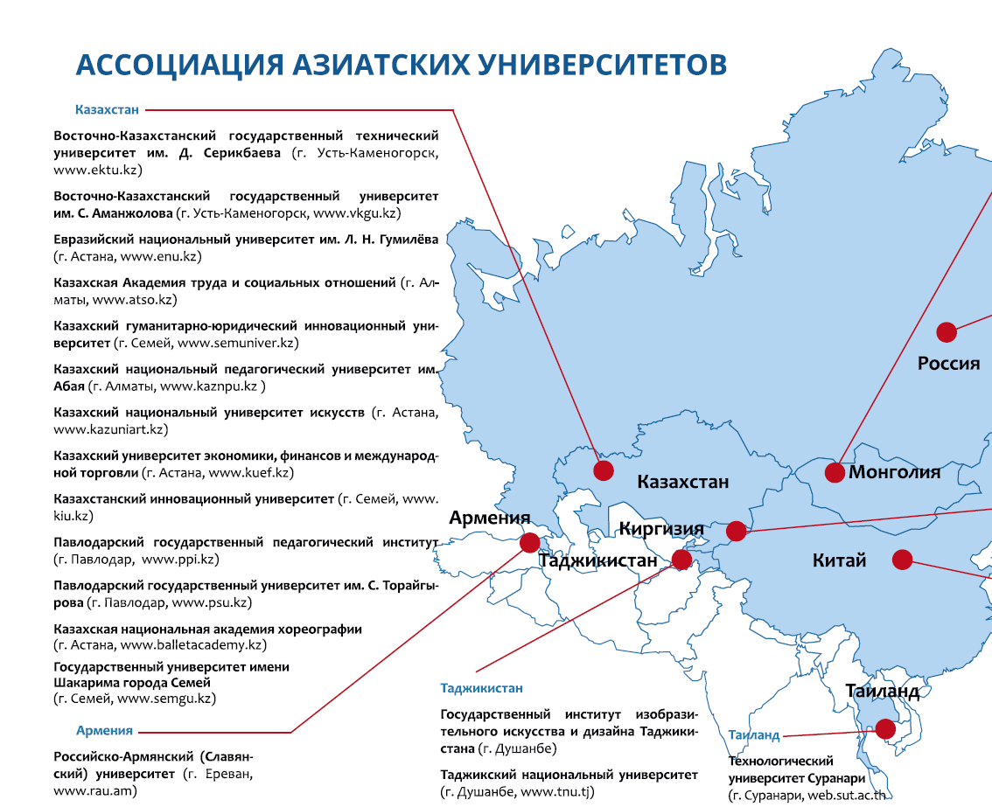
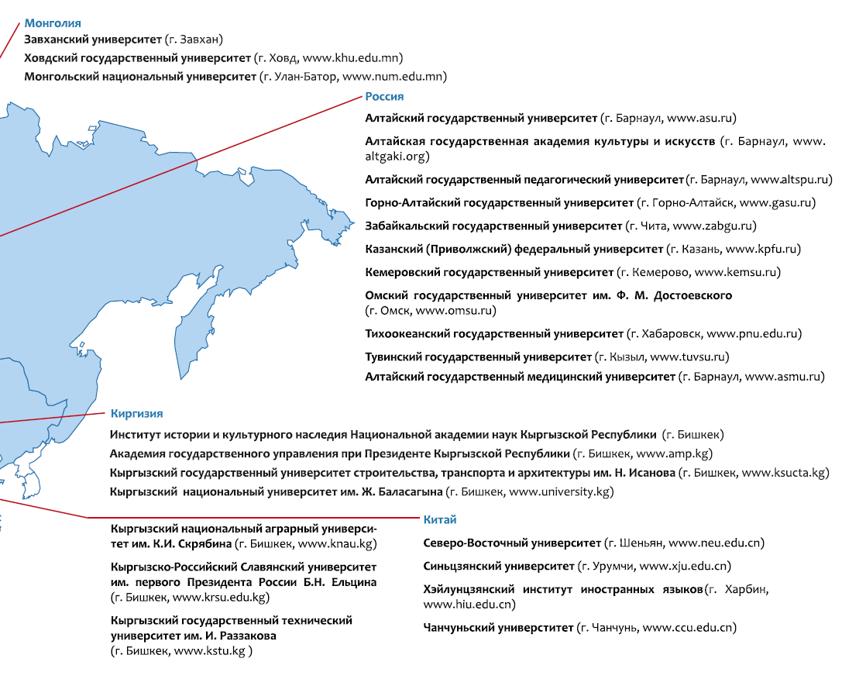
Association of Asian Universities
(established in 2013 under the auspices of ASU , 42 universities, 8 countries)

Slide 9
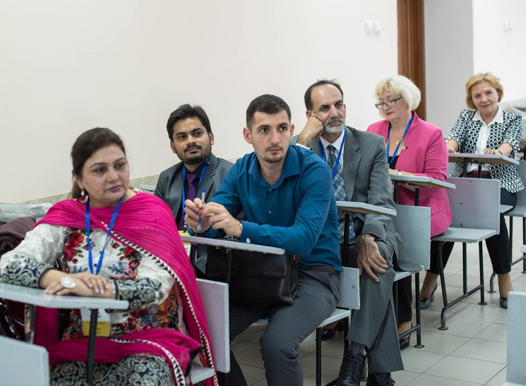
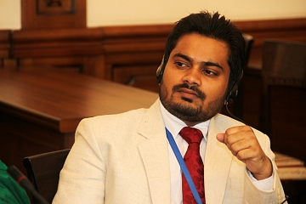
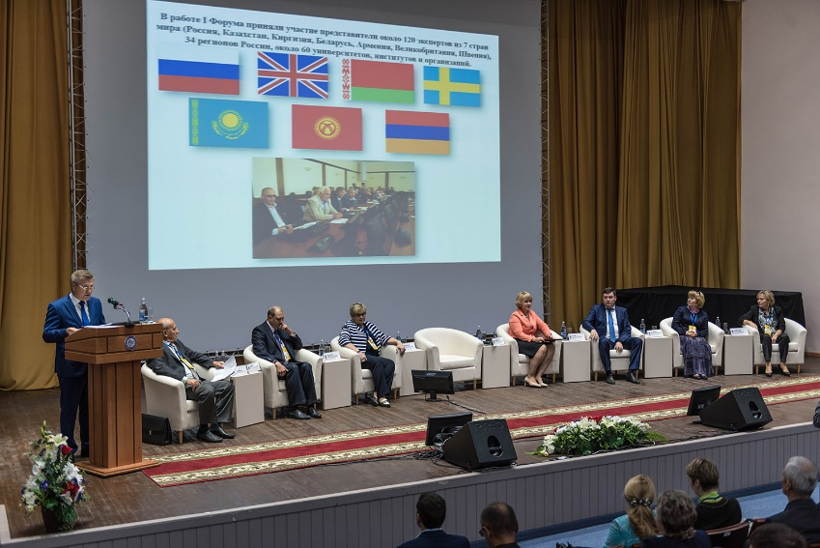
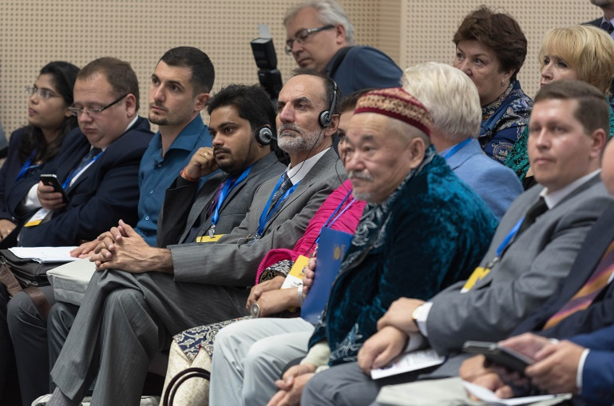
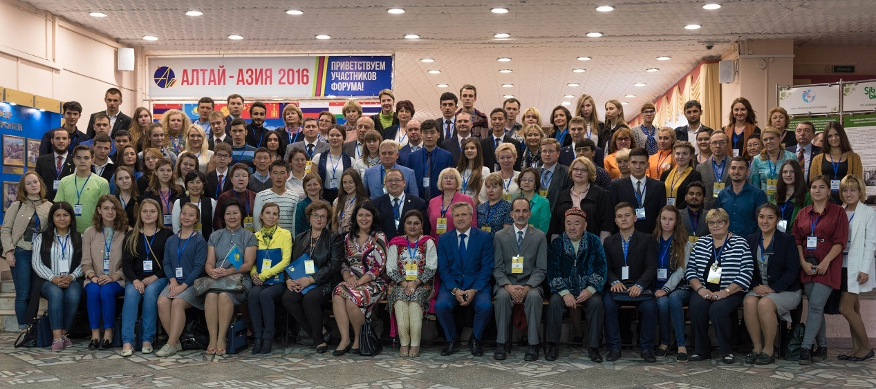
III International Educational Forum
«Altai-Asia 2016 : Eurasian educational space –
new challenges and best practices»
22-23th September, 2016. Barnaul
14-18 сентября 2017 г. Барнаул – Горный Алтай
more than 40 foreign experts - scientists and teachers from universities in Austria, India, Pakistan, Afghanistan, Armenia, Tajikistan, Kazakhstan, China, Mongolia, Uzbekistan and Kyrgyzstan. Specialists from 29 universities of the Russian Federation from Moscow, St. Petersburg, Tomsk, Simferopol, Bryansk, Ulan-Ude, Orenburg, Abakan, Omsk, Chelyabinsk, Krasnoyarsk, etc.

Slide 10


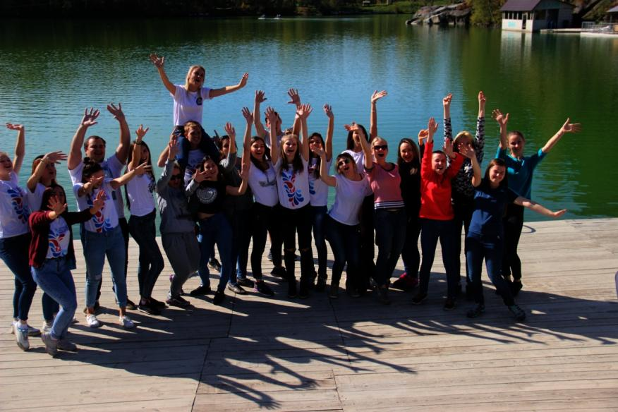
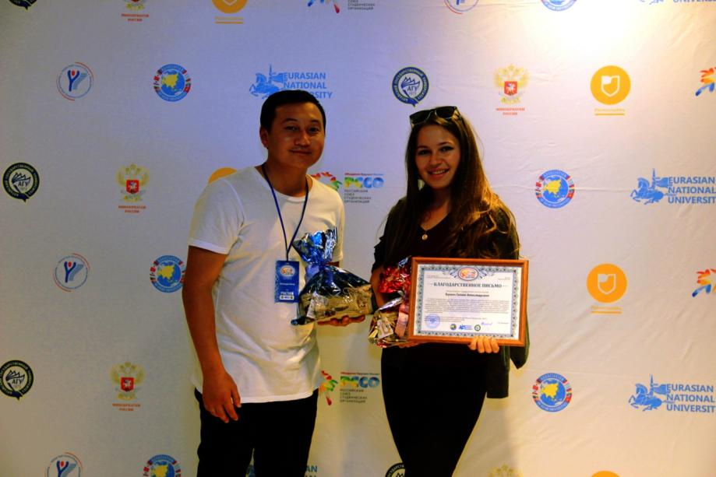
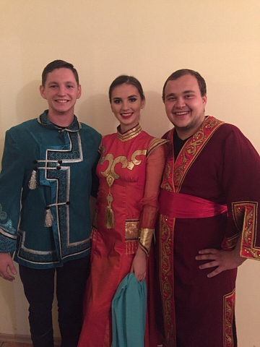
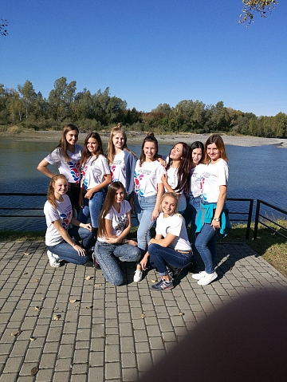

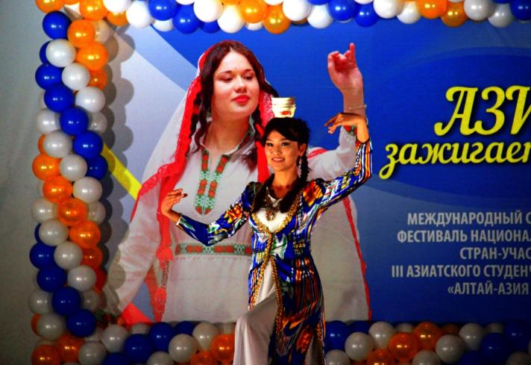
III Asian Students Forum
Co-organizers:
Altai State University (Russia)
L.N.Gumilev Eurasian National University (Astana, Kazakhstan)
14-18th September 2017. Barnaul – Altai Mountains
More than 200 participants representing 27 universities from 8 countries, 5 sections, students festival, 15 projects-laureats

Slide 11

IN 2017 ASU BECAME THE WINNER OF CONTEST OF MINISTRY OF EDUCATION AND SCIENCE OF THE RUSSIAN FEDERATION AND RECEIVED THE STATUS OF FLAGSHIP UNIVERSITY OF RUSSIA
Mission
The leading center for the training of highly qualified specialists for the region, Russia and the countries of Central Asia, competing at the world level.
to create an intellectual elite
to develop breakthrough directions of scientific research
Center for concentration and transfer of advanced scientific knowledge and technologies based on the development and use of modern research facilities, inviting leading scientists, attracting talented students, creating a creative atmosphere and comprehensive management system.
Modern
multidisciplinary
scientific and educational center
The largest integration center with universities in Central Asia, holding leading positions in the export of education and development and transfer of the best educational practices, advanced scientific developments and experience in humanitarian cooperation.
to produce new knowledge, integrate and disseminate best practices
to realize cultural and expert potential and make an impact on social development
Center for Social Development, ensuring the formation of personal qualities and values of the future political, economic, scientific and educational elite.
Notes:
В рамках проекта будут разработаны модели университетских центров инновационного, технологического и социального развития регионов, обеспечивающих капитализацию образовательных, научных и технологических результатов, с учетом стратегий развития регионов. Также будет распространен опыта по развитию ведущих университетов на более широкий круг вузов.
В данный проект интегрируется программа 5/100 и программа создания и развития опорных университетов. В него органично вписываются проекты создания инжиниринговых центров, проектная деятельность по созданию при вузах совместных с бизнесом предприятий, программа поддержки педагогических вузов, мероприятия по созданию базовых кафедр, а также иные ключевые проекты государственной программы развития образования.
По нашему мнению, ведущие университеты, имеющие достаточно развитую научно-исследовательскую, инновационную и социальную инфраструктуру, смогут и должны стать университетскими центрами в своих регионах.

Slide 12

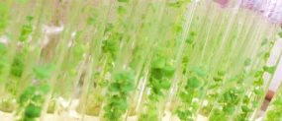
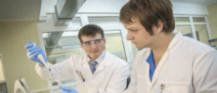

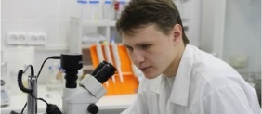



Priority research directions
Agrobiotechnology
Biological medicine and chemical-pharmaceutical technologies
Geoecological monitoring and environmental management
Biological diversity studies and protection
IT and mathematical modelling
Material Science and the Creation of New Materials with Specified Properties
Analysis and forecasting of ethnocultural, socio-economic, humanitarian and geopolitical processes in the transboundary space of Russia and Central Asia

Slide 13
Directions for new educational programs:
Agrobiotechnologies and environmental management
Biomedicine and chemical-pharmaceutical
Resort and tourism development
Analysis and forecasting of ethnocultural, socio-economic, humanitarian and geopolitical processes in the transboundary space of Russia and Central Asia

Slide 14



Biological medicine
and chemical-pharmaceutical technologies
Внедрение инновационных методов получения и использования лекарственного сырья природного происхождения
и лекарственных средств на его основе
The goal: to create innovative methods for the production and use of medicinal natural raw materials and products based on modern achievements in chemistry, biotechnology and bioengineering
Getting high-quality
medicinal raw materials
Creation of methods for quality control
of medicines and dietary supplements
Creation of medicines from
natural raw materials
Introducing new species and selection of medicinal plants
Expressing methods for determining the species composition of plant components that are part of food and dietary supplements, as well as raw materials
Stimulating regeneration processes
Preventing acute cardiovascular events
Adaptogens
Improving biotechnological methods of obtaining medicinal plant raw materials

Slide 15



Biological medicine
and chemical-pharmaceutical technologies
Создание и внедрение инновационных средств диагностики и лечения онкологических заболеваний
The goal: to create innovative diagnostic tools and treatment of oncological diseases based on proteomic technologies
New approaches
to the formation of risk groups
Early diagnosis of malignant neoplasms
Therapeutic
peptides
Forming oncological risk groups using modern information technologies
Personalized approaches to the prevention of malignant neoplasms
in risk groups
Obtaining immunosignature for the diagnosis of malignant breast and lung neoplasms
Creating a hardware-software complex for the analysis of immunosignature
Creating a prototype diagnostic test.
Forming the biobank serum samples for validation of tests
Determining peptides with affinity for receptors of immune cells
Evaluating immunomodulating and antitumor properties of peptides
Developing an immunomodulating drug for the treatment of patients with malignant neoplasms
Modern proteomic technologies

Slide 16
Perspective directions of cooperation of ASU with universities of India
Training of specialists in biomedicine and the whole range of chemical-pharmaceutical field
Expert and analytical work on the problems of Central Asia
Joint scientific projects:
  research and creation of medicines based on natural plants
  early diagnosis of cancer by immunosignature and the creation of new generation peptide drugs
Youth cooperation under the aegis of the Association of Asian Universities

Slide 17

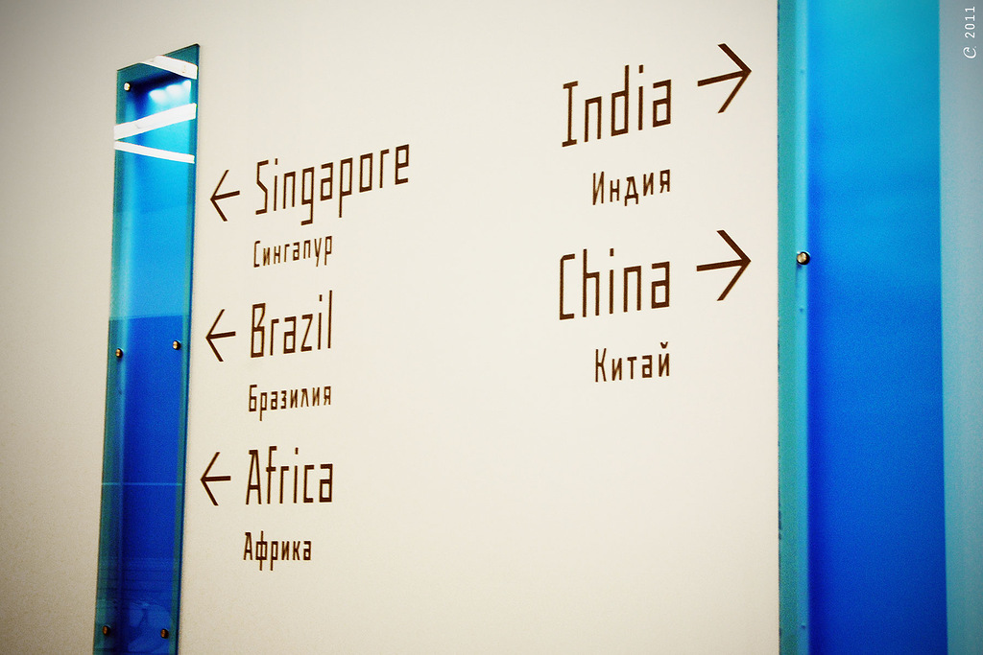

Altai State University
Thank you!

