Slide 1

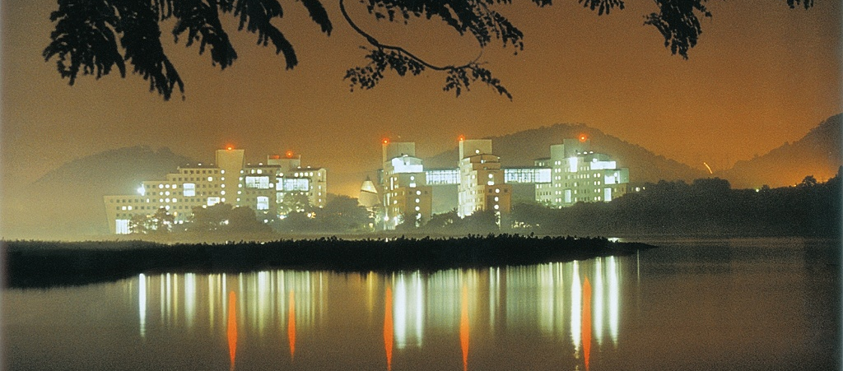
IIT Bombay- Moving towards excellence in Higher Education and Research
Indian Institute of Technology Bombay, India
R. O. Dusane
Dean IR

Slide 2
IIT Bombay Statistics
Campus Area : 530 acres
Faculty Strength : 629 full time, 100 adjunct
Bachelors Degree Students : ~4141
Masters Degree Students : ~3404
Doctoral Degree Students : ~3022
Total No. of Students : ~10169

Slide 3
Academic Units
Science and Engineering Departments
Aerospace Engineering
Biosciences & Bioengineering
Chemical Engineering
Chemistry
Civil Engineering
Computer Science & Engineering
Earth Sciences
Electrical Engineering
Energy Sciences & Engineering
Environmental Science and Engineering
Mathematics
Mechanical Engineering
Metallurgical Engineering & Materials Science
Natural Resource Engineering (CSRE)
Physics
Arts and Humanities Departments
Humanities and Social Sciences
Industrial Design
Management
Interdisciplinary Programs
Systems & Control
IE&OR
Technology and Development (CTARA)
MMM (Math, MEMS, Mech)
Educational Technology
Nanotechnology and Science (CRNTS)
Climate Change Studies
Urban Science and Engineering

Slide 4
Research Centres / Consortia
Centre For Urban Science And Engineering (C-USE)
Centre of Excellence in Nanoelectronics
National Solar Thermal Research, Testing and Simulation Facility
National Centre for Photovoltaic Research and Education
TTSL - IITB Centre of Excellence in Telecom
National Centre for Aerospace Innovation and Research
Centre of Excellence in Steel Technology

Slide 5





































Partners in various modes
of collaboration
Student sponsorships
R&D projects
Labs & Facilities
Chair Professorship
Consortia
Licensing

Slide 6
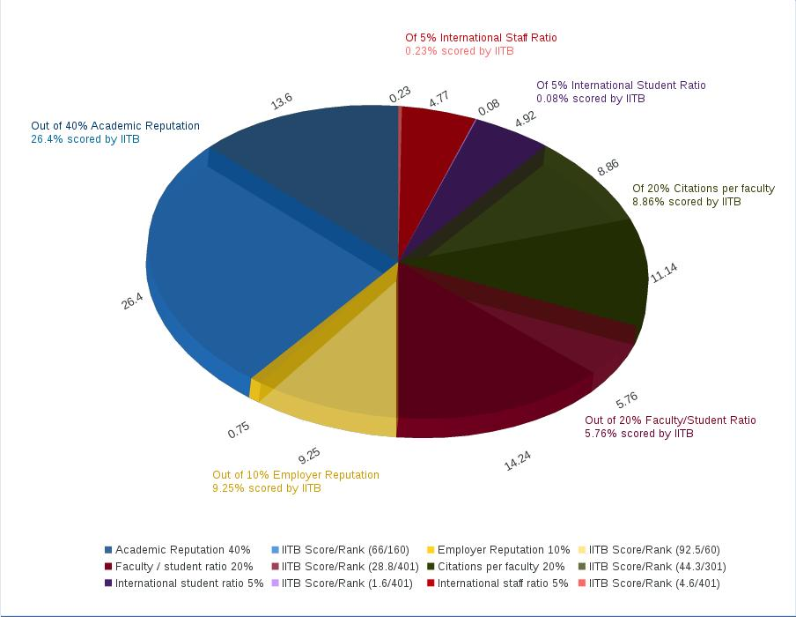
2017 QS World University Rankings: 179
Key areas of assessment and IIT Bombay's performance.

Slide 7
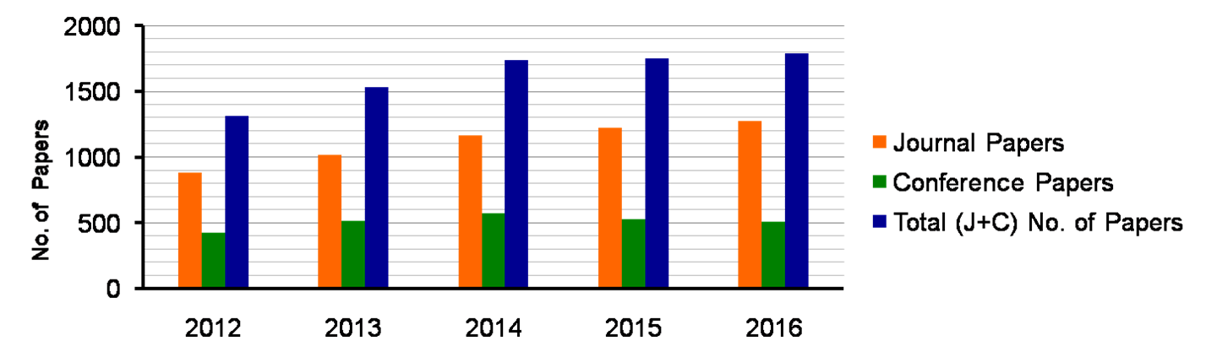
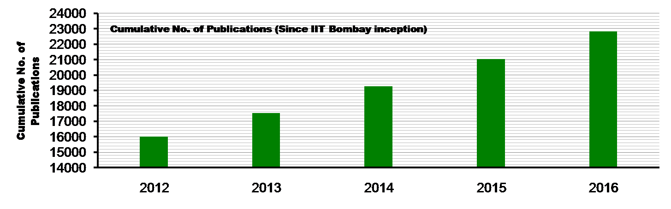
Publication Report

Slide 8
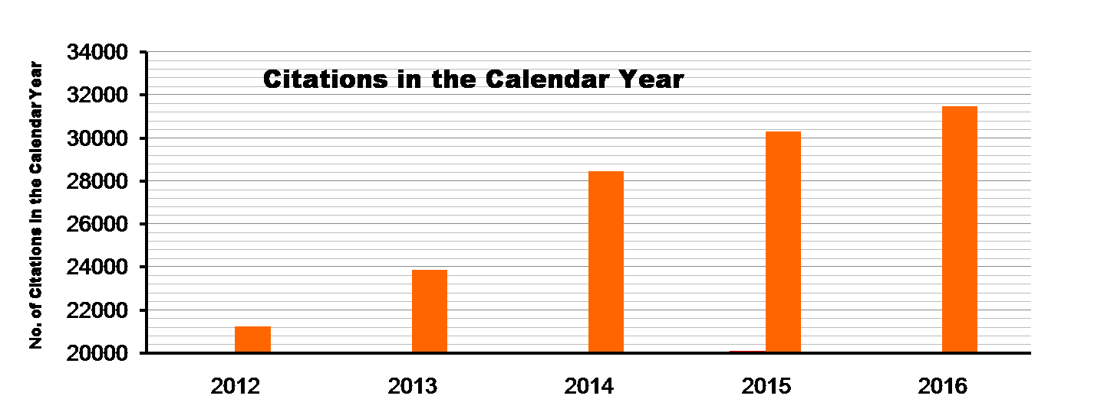
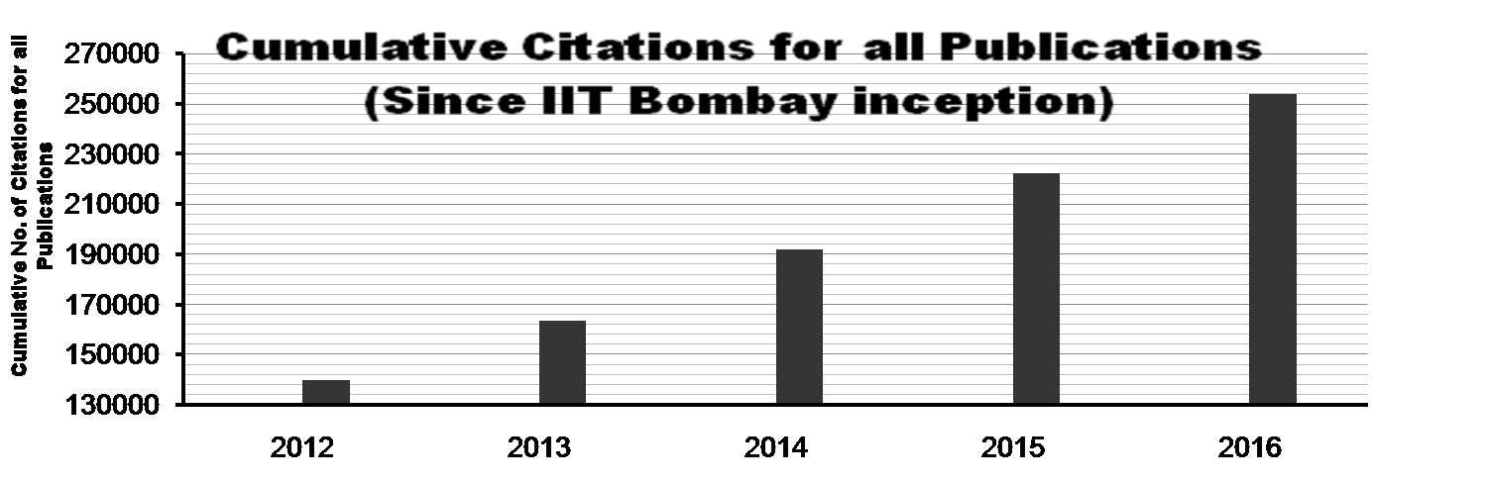
Citation Report

Slide 9
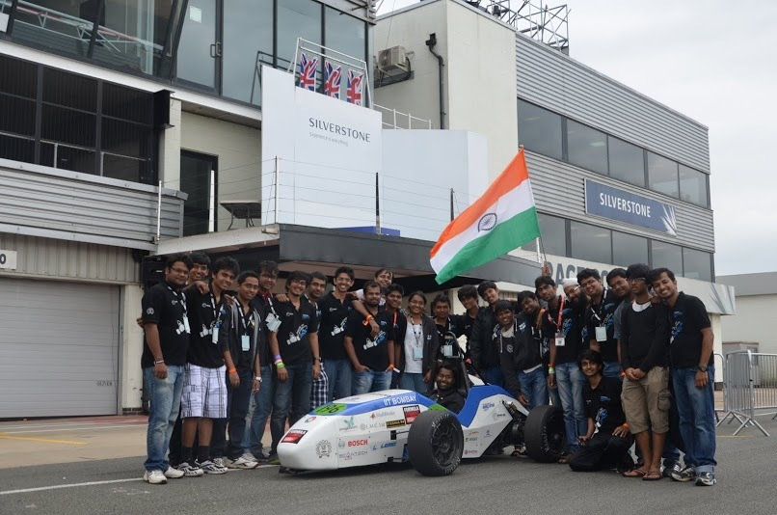
IITB Racing Team
Design and engineering amateur high performance race cars
EV3.0 came in top 10 among electric vehicles in UK in 2016

Slide 10
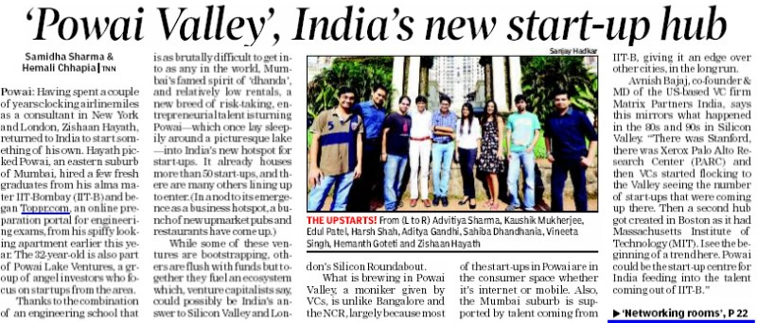
IIT Bombay is catalysing startup ecosystem in Powai
Front page Times of India, Mumbai, Jan 21, 2014

Slide 11

Society for Innovation and Entrepreneurship (SINE)
www.sineiitb.org
IITBombay

Slide 12












Few of our Companies

Slide 13

IIT Bombay-Monash University Research Academy

Slide 14


Energy Science and Engineering + Environmental Science and Engineering

Slide 15


Guest House 3

Slide 16
International Partnerships
2008 - Formal launch of the IIT Bombay-Monash Research Academy
(A Section 25 Company to administer the Joint Ph.D. program between IITB and Monash University, Australia. At present 175 students are enrolled for Ph.D. with 90 faculty members from both institutes as Supervisors).
IIT Bombay – National University of Singapore JDP program
IIT Bombay – University of Wollongong JDP program
IIT Bombay – University of Alberta Jointly Supervised Ph.D program
IIT Bombay – Freie University of Berlin Jointly Supervised Ph.D program
IIT Bombay – Simon Fraser University Jointly Supervised Ph.D program
IIT Bombay – WUStL EMBA program
IIT Bombay – Thales Systemes Aeroportes Industry Sponsored Ph.D Fellowship
CONSORTIA
Indo – Finnish Consortium - formed 2014
Russia-India Network of Institutions of Higher Education (RIN) formed 2015:-
Coordinators: IIT Bombay (Indian Universities)
Tomsk University (Russian Universities)

Slide 17
International Partnerships
IIT Bombay – French Network:- Members: IIT Bombay, CNRS, Telecom Bretagne, UBO, UBS, ENIB, ENSTA Bretagne
Global Tech Alliance :- Members: NTU, Caltech, Georgia Tech, ETH Zurich, Imperial College, Shanghai Jiao Tong University, and TUM. Organized a workshop on Energy Research for Global Sustainability at IITB
Center for Urban Science and Progress (CUSP) :- New York City, with IIT Bombay as one of the consortium
IITs and Paristech :- A consortium of older IITs and the Paristech group FRANCE for an exchange program for students. IIT Bombay as Coordinator
Asian Universities Alliance :- From India IIT Bombay and one top HEI from each asian countries
Heritage Network:- Members: EC Nantes, CTU, Instituto Superior Technico,
Politecnico di Milano, ETSI Sevilla, Warsaw Univ of Technology

Slide 18
International Partnerships
International Workshops:-
IITB-NUS joint workshop on “Energy Generation and Storage” – 2014 and 2015
IITB-Ohio Univ.2014 and 2015 (in Ohio, USA)
IITB-RWU (Rhine-Waal Univ. Germany) – 2014
IITB-NCCU, Taiwan 2015
IITB-IU (USA) – 2015 and 2016
IITB- Curtin University – 2016
IITB – NCTU, Taiwan – 2016
IITB- University of Alberta – IC-IMPACTS – 2016
IITB- Freie University Berlin under IGP – 2016
IITB- University of Sydney - 2016 and 2017
IITB- Aalto University, Mini Symposium- 2017
International Approaches:
a) Scholarships and Fee-waiver schemes for international PhD. Students
b) Enabling Foreign student intake in IITB-Monash Academy,
c) Special DAAD scholarships for students from Bangladesh and Nepal
d) JEE (Advance) and GATE examination in 6 foreign countries including UAE, Nepal, Singapore, Bangladesh, Sri Lanka and Ethiopia.
FOREIGN LANGUAGE CLASSES for our students and staff:
French , German, Chinese, Japanese, Italian and Persian

Slide 19
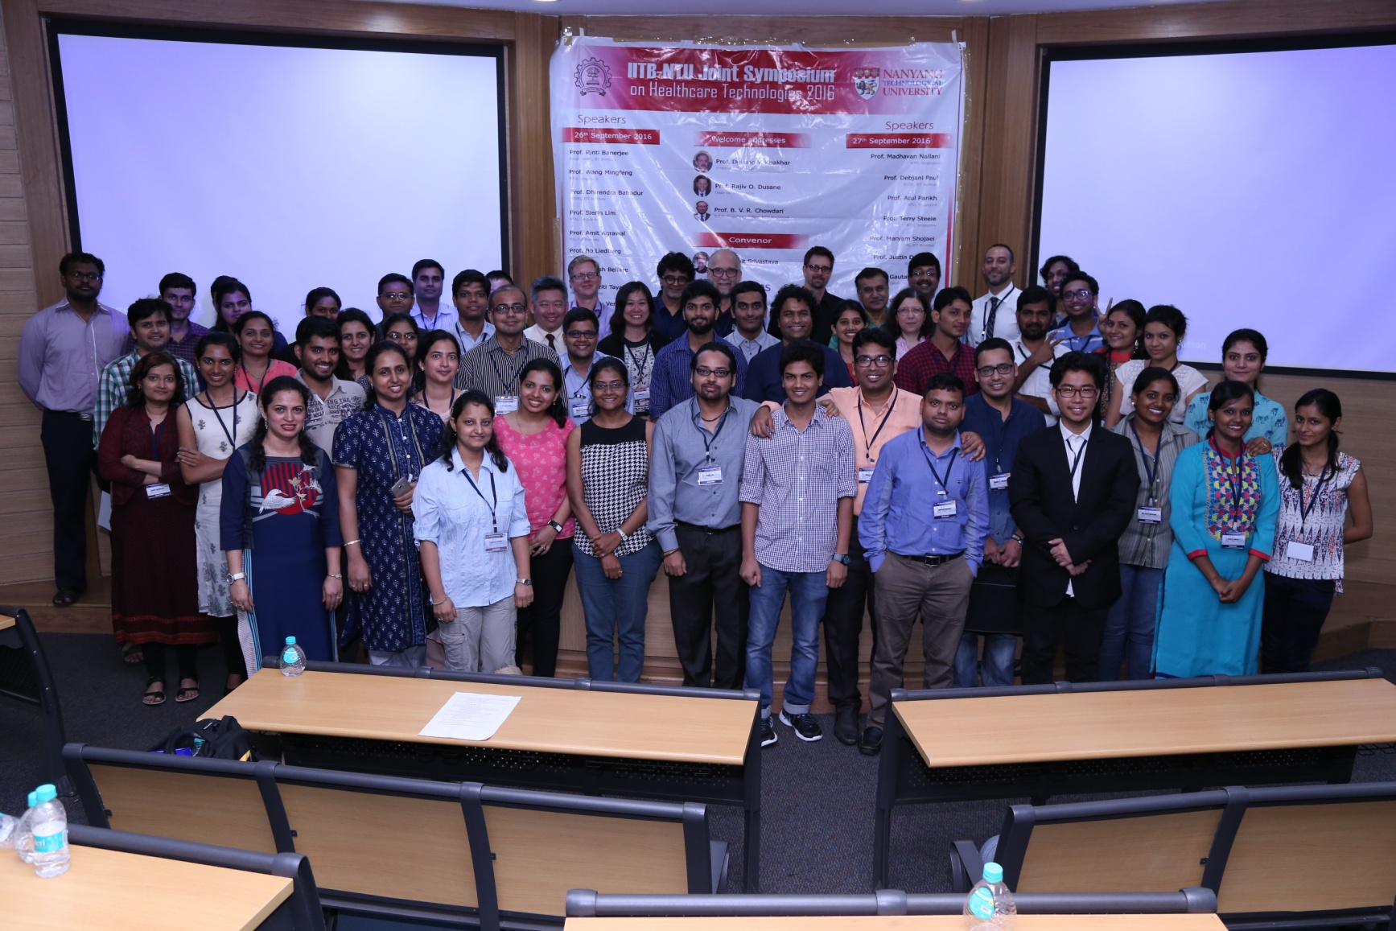
The joint workshop at IIT B on Health monitoring devices

Slide 20
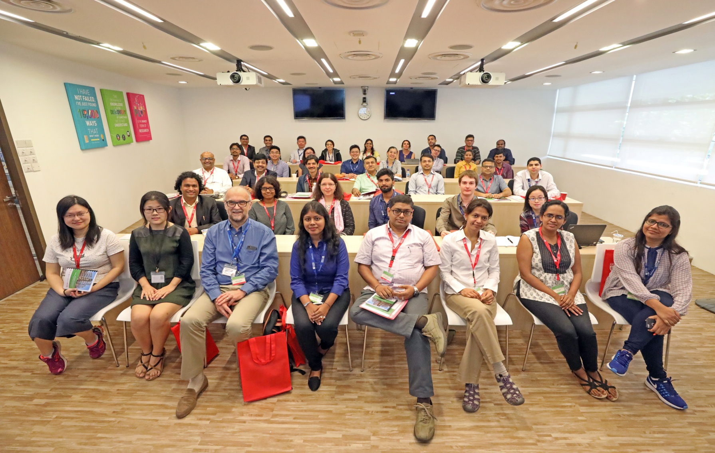
The joint workshop at NTU on Health monitoring devices

Slide 21
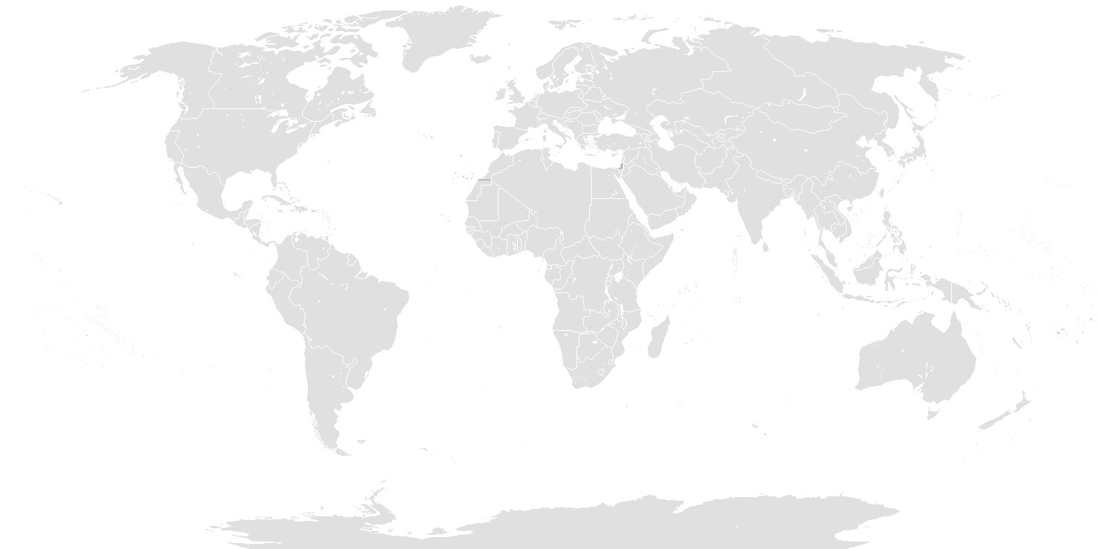
We would like to strengthen
The partnerships under RIN
Thank you...

