Slide 1
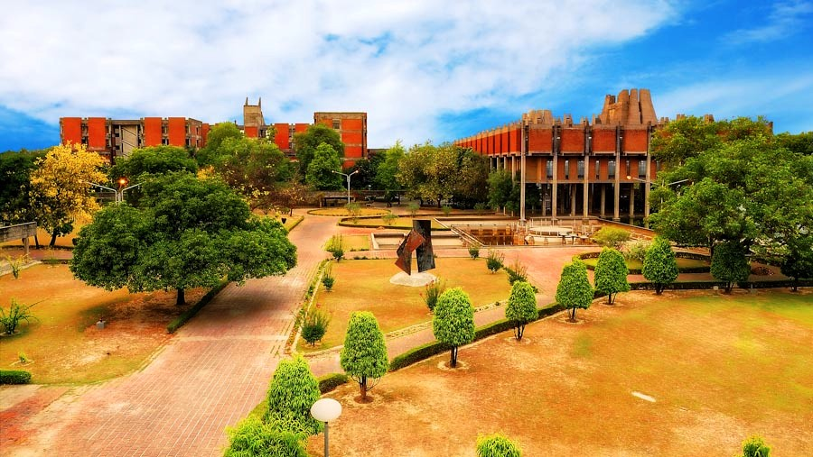
Office of International Relations
Office of International Relations
INDIAN INSTITUTE OF TECHNOLOGY KANPUR
INDIAN INSTITUTE OF TECHNOLOGY KANPUR
INDIAN INSTITUTE OF TECHNOLOGY KANPUR
Office of International Relations
Office of International Relations

Slide 2
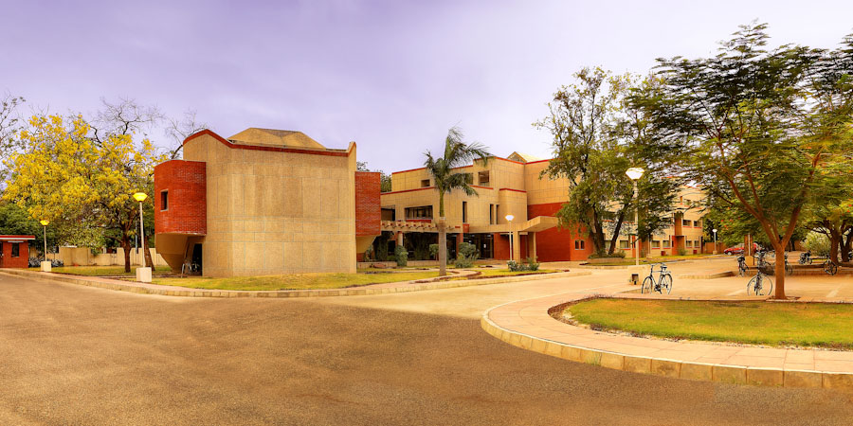
Indian Institute of Technology Kanpur

Slide 3
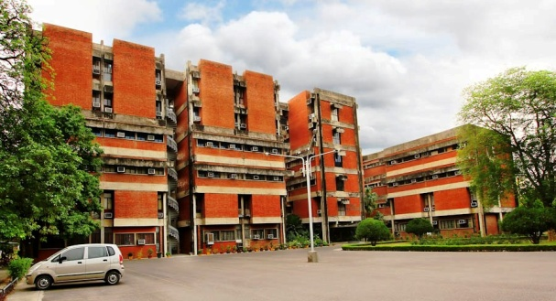
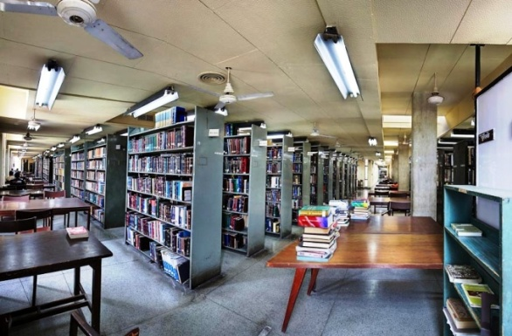
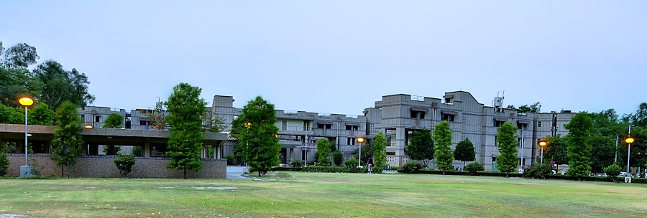
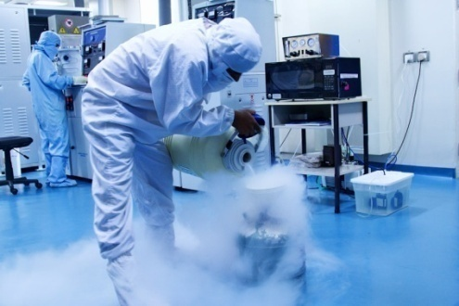
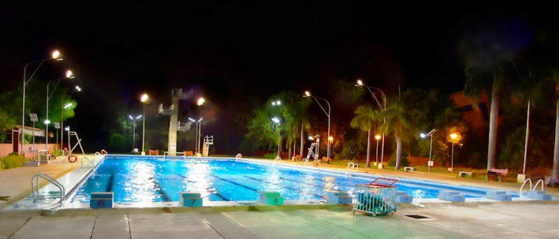
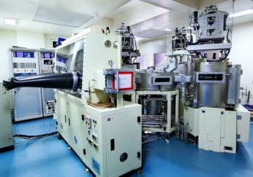
Indian Institute of Technology Kanpur
IIT K @ a GLANCE
Established 1959
Faculty Members 400
Students More than 6500
Undergraduate 3960
Postgraduate 2540
Alumni more than 35,000
Campus Area (acres) 1055
Halls of Residence 13
Excellent Infrastructure
(Academic, Residential
and Sports)
Primary Health Care
Facility

Slide 4
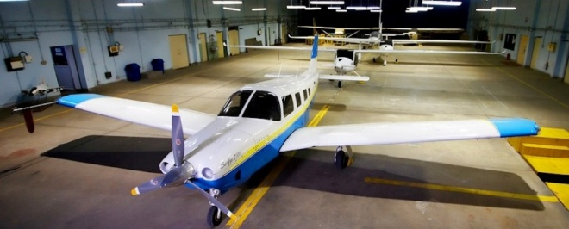
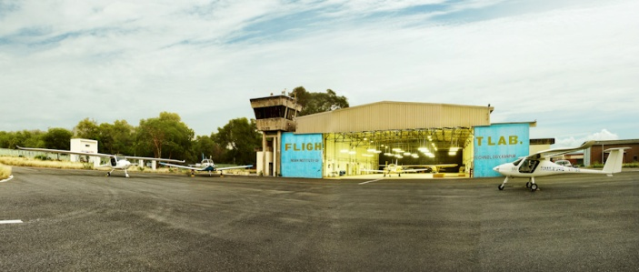
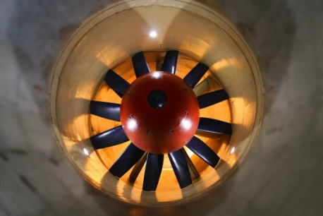
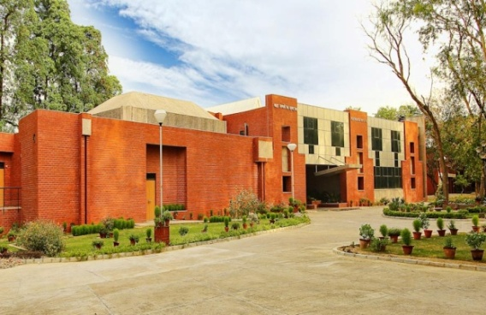
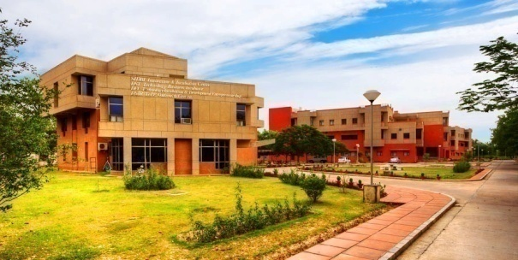
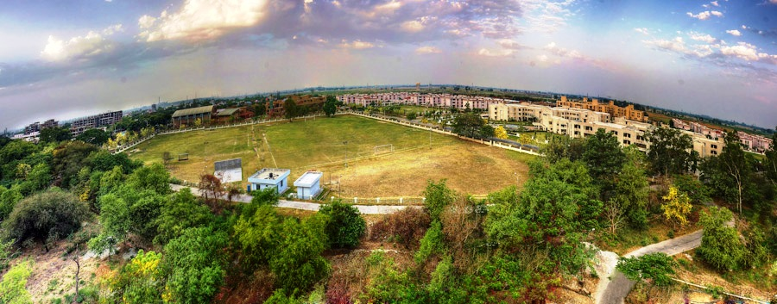
Indian Institute of Technology Kanpur
IIT K @ a GLANCE
Air Strip and Aircrafts
National Wind Tunnel Facility
3 GBPS Internet Bandwidth
Counselling Service
Student Clubs
Samtel Center
Student Placement Office
SIDBI Incubation Center
Fully Residential Campus
Offices in NOIDA, NewYork

Slide 5
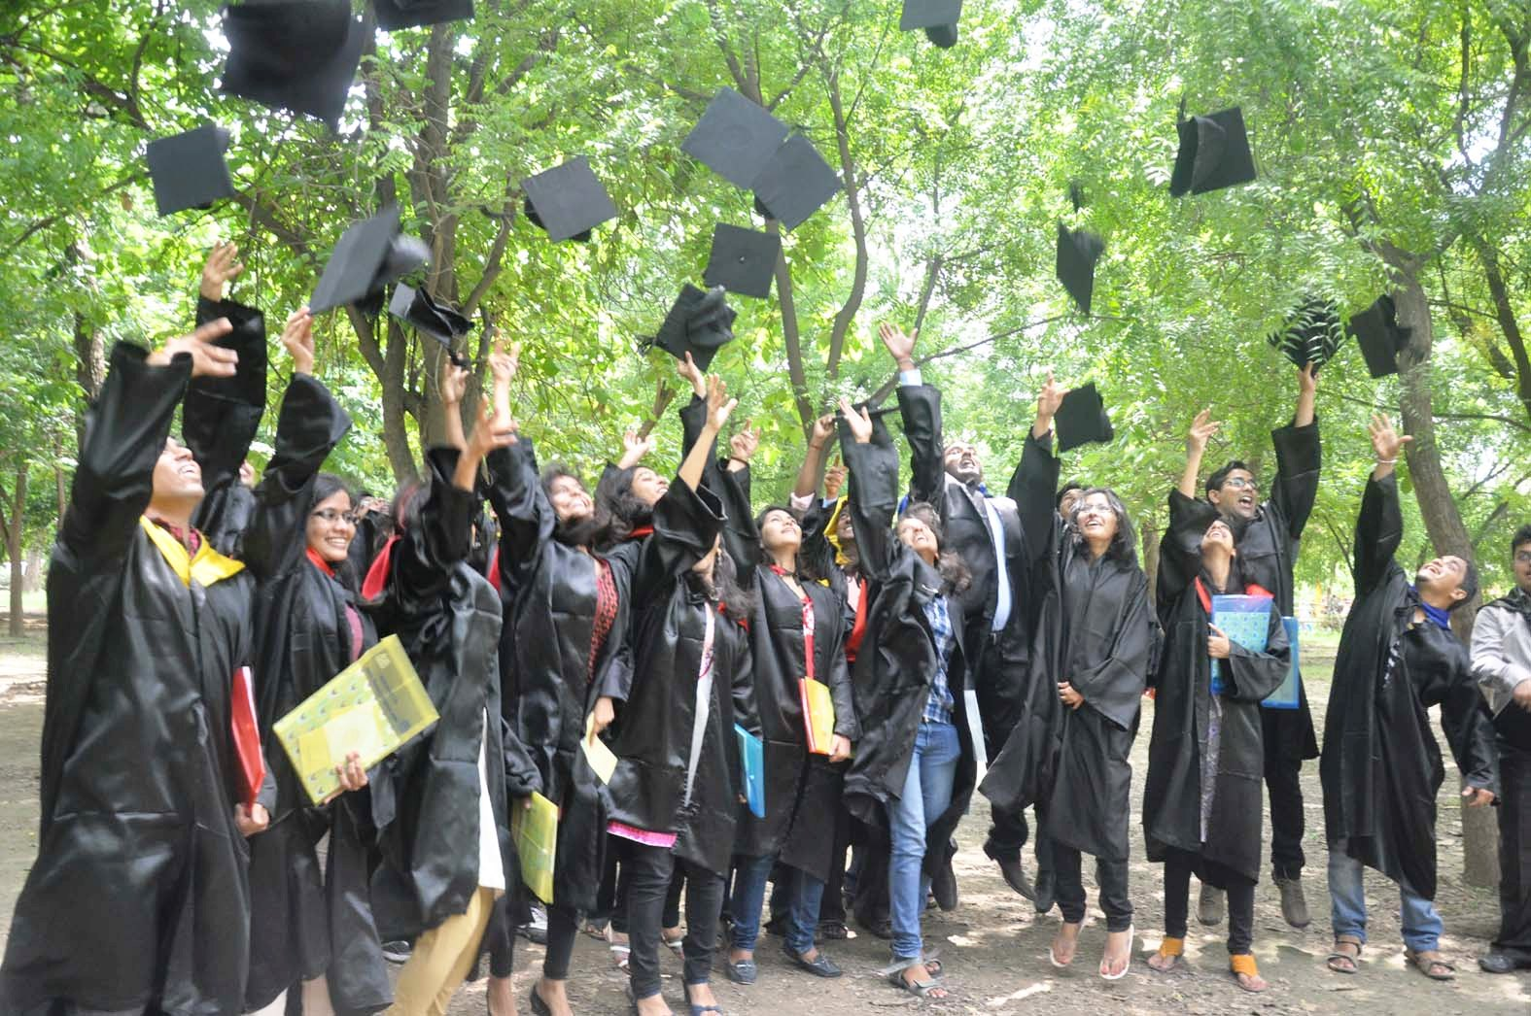
Indian Institute of Technology Kanpur
Programmes
Bachelor of Technology
(B. Tech)
Bachelor of Science
(B. S)
Master of Science (2 years)
(M. S)
Master of Technology
(M. Tech)
Master of Design
(M. Des)
Doctor of Philosophy
(Ph .D.)
Master in
Business Administration
(MBA)

Slide 6
Role of International Relations
Office of International Relations
Office of International Relations
INDIAN INSTITUTE OF TECHNOLOGY KANPUR
INDIAN INSTITUTE OF TECHNOLOGY KANPUR
INDIAN INSTITUTE OF TECHNOLOGY KANPUR
Office of International Relations
Interface between IITK and Overseas Academic Community

Slide 7
Office of International Relations
Office of International Relations
INDIAN INSTITUTE OF TECHNOLOGY KANPUR
INDIAN INSTITUTE OF TECHNOLOGY KANPUR
INDIAN INSTITUTE OF TECHNOLOGY KANPUR
Office of International Relations
Roles of IR
Foster International Partnerships and Research Collaborations
Develop and Facilitate Student Exchange Programme
Draft fresh MoUs and renew the existing one
Facilitate arrival of incoming overseas visitors
Provide information to students pertaining to the institute
surroundings, scholarships and programmes
Provide assistance pertaining to all admission related formalities
Arrange for an orientation programme for incoming overseas
students
Make strategies to improve academic collaboration and to attract
more overseas students and visiting faculty members

Slide 8
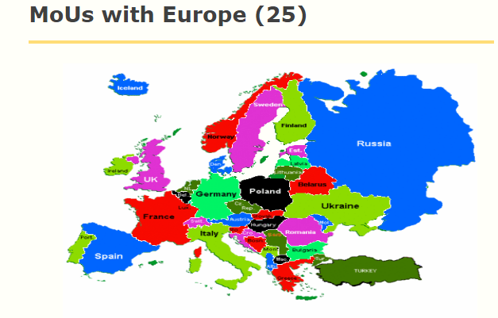
Office of International Relations
Office of International Relations
INDIAN INSTITUTE OF TECHNOLOGY KANPUR
INDIAN INSTITUTE OF TECHNOLOGY KANPUR
INDIAN INSTITUTE OF TECHNOLOGY KANPUR
Office of International Relations

Slide 9
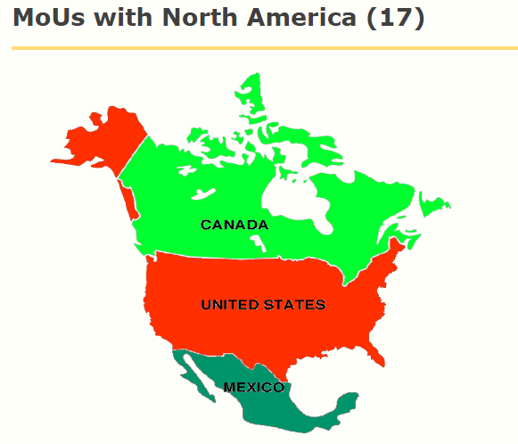
Office of International Relations
Office of International Relations
INDIAN INSTITUTE OF TECHNOLOGY KANPUR
INDIAN INSTITUTE OF TECHNOLOGY KANPUR
INDIAN INSTITUTE OF TECHNOLOGY KANPUR
Office of International Relations

Slide 10
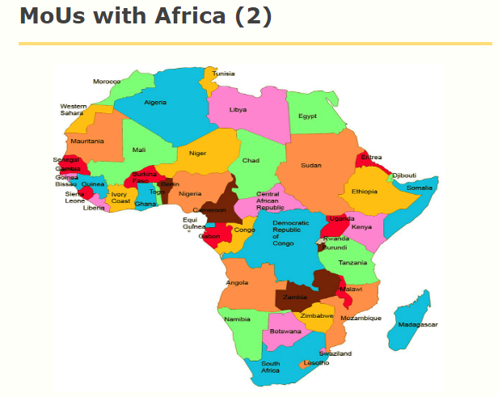
Office of International Relations
Office of International Relations
INDIAN INSTITUTE OF TECHNOLOGY KANPUR
INDIAN INSTITUTE OF TECHNOLOGY KANPUR
INDIAN INSTITUTE OF TECHNOLOGY KANPUR
Office of International Relations

Slide 11
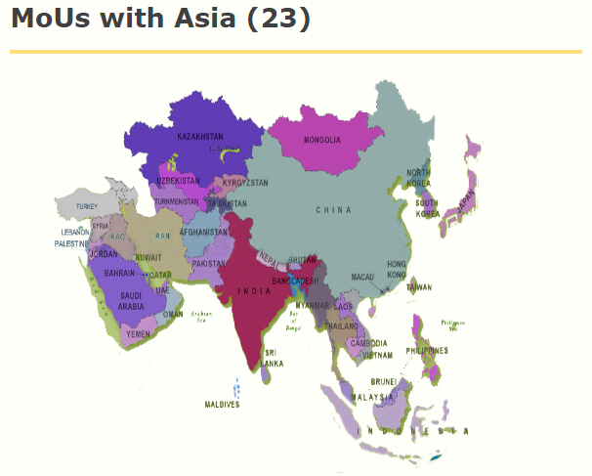
Office of International Relations
Office of International Relations
INDIAN INSTITUTE OF TECHNOLOGY KANPUR
INDIAN INSTITUTE OF TECHNOLOGY KANPUR
INDIAN INSTITUTE OF TECHNOLOGY KANPUR
Office of International Relations

Slide 12
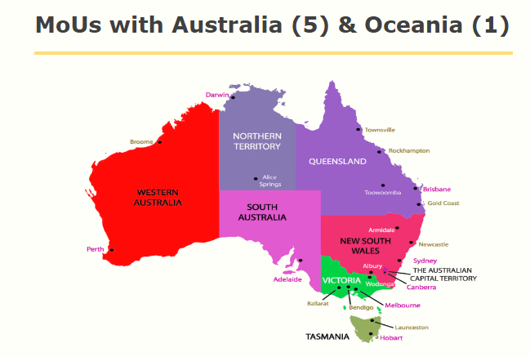
Office of International Relations
Office of International Relations
INDIAN INSTITUTE OF TECHNOLOGY KANPUR
INDIAN INSTITUTE OF TECHNOLOGY KANPUR
INDIAN INSTITUTE OF TECHNOLOGY KANPUR
Office of International Relations

Slide 13
Office of International Relations
Office of International Relations
INDIAN INSTITUTE OF TECHNOLOGY KANPUR
INDIAN INSTITUTE OF TECHNOLOGY KANPUR
INDIAN INSTITUTE OF TECHNOLOGY KANPUR
Office of International Relations
Number of IITK MoUs - Summary
Types of MoUs
5
3
Total -71
73

Slide 14
Office of International Relations
Office of International Relations
INDIAN INSTITUTE OF TECHNOLOGY KANPUR
INDIAN INSTITUTE OF TECHNOLOGY KANPUR
INDIAN INSTITUTE OF TECHNOLOGY KANPUR
Office of International Relations
Opportunities and Avenues for IITK and overseas students
Few Highly Active Programmes
IITK-NUS Joint Doctoral Degree Programme
Melbourne India Post Graduate Programme (MIPP)
IITK- University of Buffalo Joint Doctoral Degree Programme
IITK-TAMU Research exchange/internships
SURGE –IITK and University of Melbourne Programme
Erasmus Mundus Programmes, EU
Tomsk Polytechnic University, Russia
Indo-Canada Shashtri Programme

Slide 15
Office of International Relations
Office of International Relations
INDIAN INSTITUTE OF TECHNOLOGY KANPUR
INDIAN INSTITUTE OF TECHNOLOGY KANPUR
INDIAN INSTITUTE OF TECHNOLOGY KANPUR
Office of International Relations
IITK-NUS Joint Doctoral Degree Programme
The JDP is a joint research programme leading to the award of a PhD. Joint Degree Students will be registered with both NUS and IITK.
Expected intake into the JDP will be approximately three (3) to five (5) students from each Party.
The Joint Degree Student will pay tuition fees to their respective Home Institution, even while they are undertaking courses at the Host Institution.
A one-time subsidy up to $500 will be provided by the home university towards airfare to their Joint Degree Students to facilitate their travel to and from the respective Host Institution.

Slide 16
Office of International Relations
Office of International Relations
INDIAN INSTITUTE OF TECHNOLOGY KANPUR
INDIAN INSTITUTE OF TECHNOLOGY KANPUR
INDIAN INSTITUTE OF TECHNOLOGY KANPUR
Office of International Relations
University of Melbourne – IIT Kanpur Joint Degree Programme (MIPP)
Programme approved by respective Universities
Students will be awarded degree from both University of Melbourne and IIT Kanpur
Students to have supervisors in both places
Students to be examined by both University
Attractive programme for students

Slide 17
Office of International Relations
Office of International Relations
INDIAN INSTITUTE OF TECHNOLOGY KANPUR
INDIAN INSTITUTE OF TECHNOLOGY KANPUR
INDIAN INSTITUTE OF TECHNOLOGY KANPUR
Office of International Relations
University of Buffalo – IIT Kanpur Joint Degree Programme
Programme recently approved by respective Universities
Students will be awarded degree from both University of Buffalo and IIT Kanpur
Students to have supervisors in both places
Students to be examined by both University
Attractive programme for students

Slide 18
Office of International Relations
Office of International Relations
INDIAN INSTITUTE OF TECHNOLOGY KANPUR
INDIAN INSTITUTE OF TECHNOLOGY KANPUR
INDIAN INSTITUTE OF TECHNOLOGY KANPUR
Office of International Relations
SURGE –IITK and University of Melbourne Programme
Under the Summer Undergraduate Research Grant for Excellence (SURGE) program:
Maximum 3 undergraduate students from IITK go to University of Melbourne in summer for 8 weeks.
Maximum 3 undergraduate students from University of Melbourne come to IIT Kanpur in winter for 10 weeks.
Under this program Rs. 3,000 per week to and airfare and logistic support to overseas students.

Slide 19
Office of International Relations
Office of International Relations
INDIAN INSTITUTE OF TECHNOLOGY KANPUR
INDIAN INSTITUTE OF TECHNOLOGY KANPUR
INDIAN INSTITUTE OF TECHNOLOGY KANPUR
Office of International Relations
IITK-TAMU Research exchange/internships
The programme is designed for Undergraduate Students
The IITK-TAMU intern programme is for the Chosen IITK students (10 max in number)
TAMU students visit IITK (12 numbers)
For IITK students, TAMU will pay USD 3500 and IITK will cover the airfare on reimbursement basis.

Slide 20
Office of International Relations
Office of International Relations
INDIAN INSTITUTE OF TECHNOLOGY KANPUR
INDIAN INSTITUTE OF TECHNOLOGY KANPUR
INDIAN INSTITUTE OF TECHNOLOGY KANPUR
Office of International Relations
Average Number of International Students in last few years
2
13
13
4
78
19
27

Slide 21
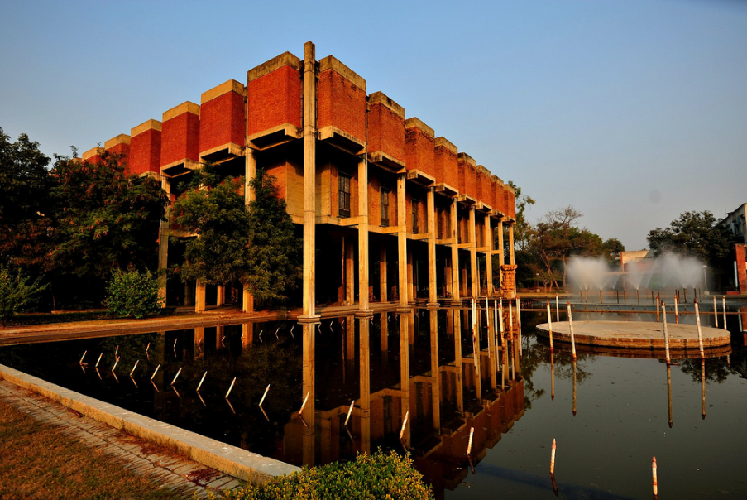
Office of International Relations
Office of International Relations
INDIAN INSTITUTE OF TECHNOLOGY KANPUR
INDIAN INSTITUTE OF TECHNOLOGY KANPUR
INDIAN INSTITUTE OF TECHNOLOGY KANPUR
Office of International Relations
IR Publications
International Relations Mosaic
IIT Kanpur Brochure

Slide 22
Office of International Relations
Office of International Relations
INDIAN INSTITUTE OF TECHNOLOGY KANPUR
INDIAN INSTITUTE OF TECHNOLOGY KANPUR
INDIAN INSTITUTE OF TECHNOLOGY KANPUR
Office of International Relations
THANK YOU
http://www.iitk.ac.in/oir/

