Slide 1
IIT Roorkee: an overview

Slide 2
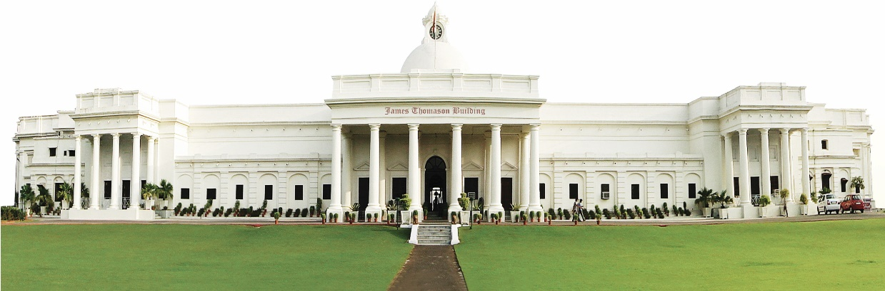
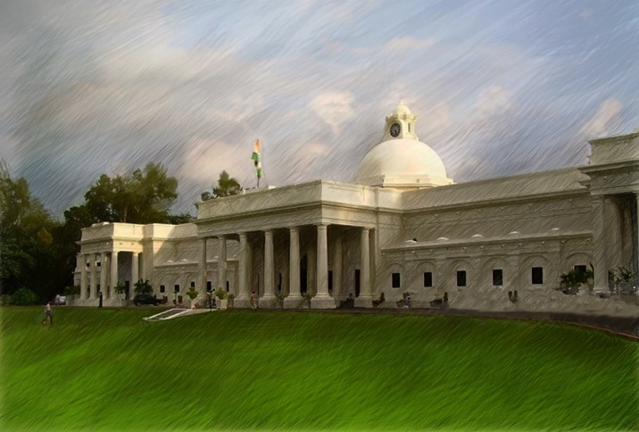
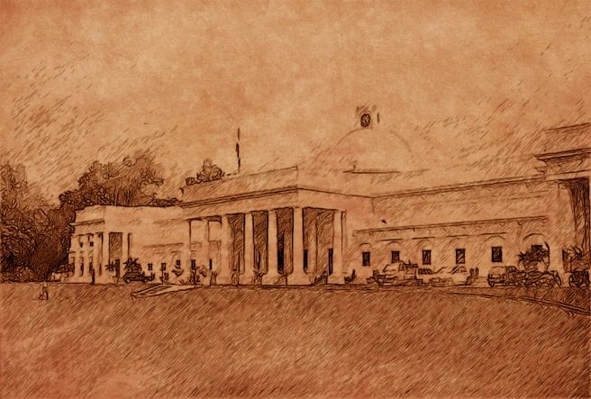
Now
2001 AD
Indian Institute of Technology Roorkee
Legacy
Circa1949 AD
Origin
Erstwile University of Roorkee
Circa1847 AD
Erstwhile Thomason College

Slide 3
IIT Roorkee : at a glance
444
Faculty
members
365
Acres at
Roorkee
7761
Students
10
Acres at
Gr. Noida
IIT ROORKEE:
AN OVERVIEW
25
Acres at
Saharanpur
850
Staff
VISION
To attain global level of excellence in education and to create a sustainable and equitable society through innovative research in science and technology

Slide 4
Academic Departments
Architecture & Planning
Bio-technology
Chemical Engineering
Chemistry
Civil Engineering
Earth Sciences
Earthquake Engineering
Electrical Engineering
Electronics & Communication Engineering
Computer Science and Engineering
Humanities & Social Sciences
Hydrology
Management Studies
Mathematics
Mechanical & Industrial Engineering
Metallurgical & Materials Engineering
Pulp and Paper Technology
Polymer and Process Engineering
Applied Sciences and Engineering
Physics
Water Resources Development and Management

Slide 5
Centres
New Centres
  Centre for Himalayan Studies
  Centre of Excellence in Urban Design and Development
  IIT Roorkee-NBCC R&D Centre on Sustainable Civil Infrastructure at Greater Noida
Academic Centre
  Alternate Hydro Energy Centre
  Institute Instrumentation center
Centers/ Hubs for specialized research
Housing Resource Center (HRC): under Housing for All mission
Centre for Railway Research (CRR)
Common Research and Technology Development Hub (CRTDH)
Centre of Excellence
Transportation Systems
Nano Technology
Disaster Mitigation & Management

Slide 6


International Collaborations (MoU s) with Universities/ Institutes
IIT ROORKEE
Saint Petersburg State University, Russian Academy of Sciences, Russia
Voith Hydro, Heidenheim, Germany
The University of British Columbia
The Governors of the University of Alberta, Canada
The University of Western Ontario, Canada
Technische Universitat Munchen (TUM) Germany
School of Technology and Architecture, Lucerne, University of Applied Sciences, HTA, Switzerland
Al Baath University of Syrian Arab Republic
University of Peradeniya, Srilanka
Linkoping University (LIU) Sweden
Lulea Tekniska Universitet (LTU) Sweden
Cardiff University, Cardiff, United Kingdom
Institute of Engineering, Tribhuvan University

Slide 7
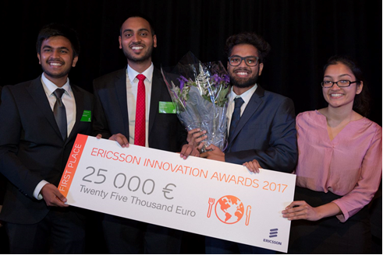
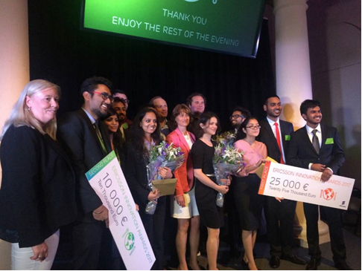
IIT Roorkee in global news
IIT Roorkee students comprising of students Ekdeep Lubana: II year,ECE department, Anisha Godha: IMT GT, IV Year, Ankit Bagaria: Chemical, III Year and Utkarsh Saxena: Metallurgy, III Year have won First prize in Ericsson Innovation Award-2017 for which the SNAP team as a part of three global finalists competed at Nobel Museum in Stockholm, Sweden.
The theme for Ericsson Innovation Awards 2017 was “Future of Food”. The IITR team developed the app ‘SNAP’ which uses a precision agriculture technology based on principles of hyper-spectral imaging of crop leaves to determine the optimum fertilizer inputs for the crop. SNAP aimed to develop low cost handheld imaging device for optimizing fertilizer use in agricultural operations thus alleviating the soil degradation from excessive use of fertilizer as well as ecosystem deterioration. The first prize of for the winner team is 25,000 Euro.

Slide 8
Association in major Schemes from Different Ministries, Govt. of India
Uchchatar Avishkar Yojana (Industry academia program)
IMPRINT (Research on combating the great challenges)
AMRUT Mission (Urban Development)
Swachh Bharat Mission (Nationwide cleanliness mission)
Pradhan Mantri Awas Yojana (Housing for All mission)
Unnat Bharat Abhiyan (Social development )

Slide 9
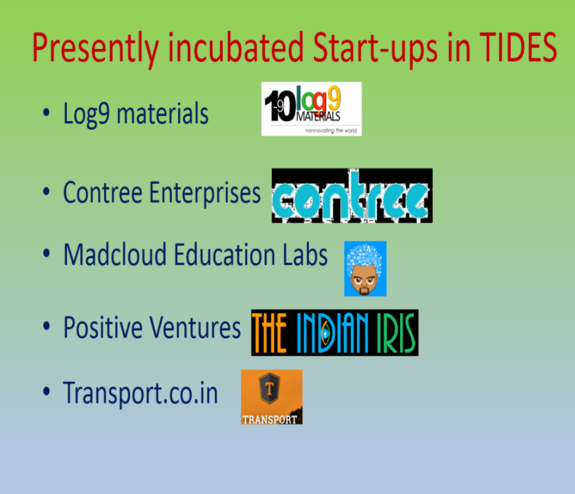
Activities in Innovation
Technology Business Incubation Center at IIT Roorkee ; Rs. 5 Crores Sanctioned by DST:
Technology Incubation and Entrepreneurship Development Society (TIEDS)
set up at IIT Roorkee
Incubated Start-Ups in TIEDS
Technology Incubation and Development of Entrepreneurs (TIDE) in the areas of Electronics and ICT – funded by DEITY (Govt. of India), Rs. 1.5 Crores
To set-up / strengthen the technology Incubation Centres and thus nurture
technology entrepreneurship development.

Slide 10
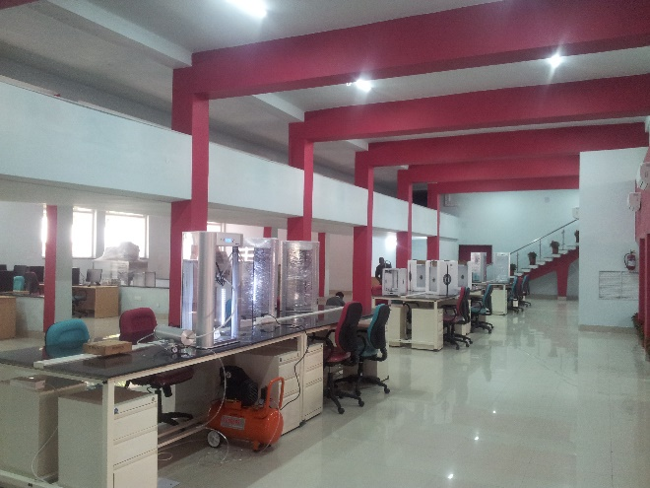
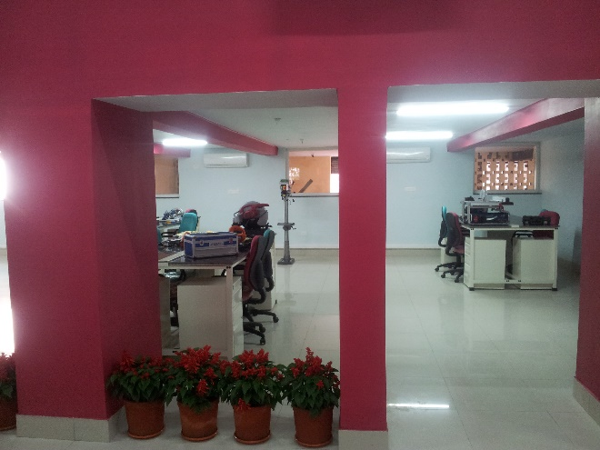
Activities in innovation
Tinkering Laboratory
A state-of-the-art laboratory with:
  no curriculum: its what an individual’s imagination allows
  no time regulations: its open 365 x 24 x 7
  no evaluation pressures: be your own judge
  no regulations: just responsible and ambitious behavior

Slide 11
Some important Research areas at IIT Roorkee
Renewable energy
Robotics and Materials science
Medical Application
Defence Application
Solar Energy
Hydro Energy
Bio Energy
Sustainable Habitat & Waste management
Social impact
Heritage preservation
Road Transport
Earthquake Proof Buildings
Vulnerability of High Speed Transportation
Water treatment
Bio-Toilets
Solid Waste Management
Healthcare and food safety
Medicinal plants
Metabolomics
Drug Design
Quality Control in Food

Slide 12
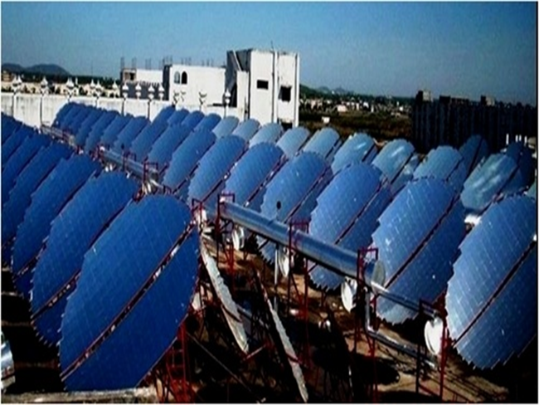
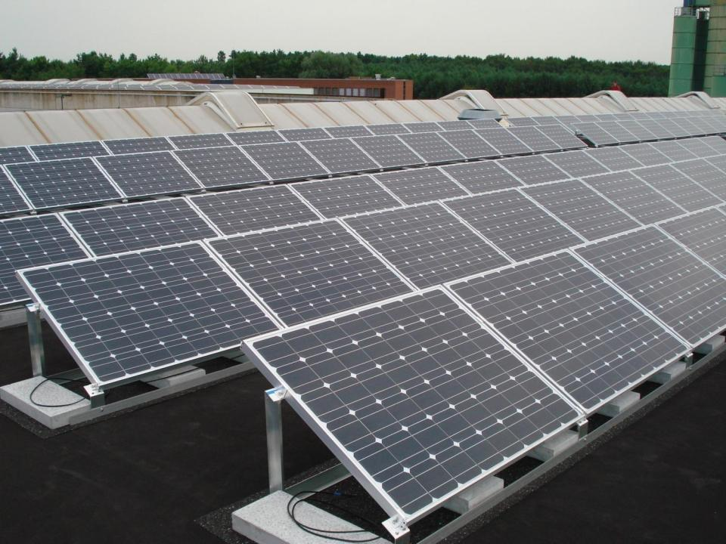
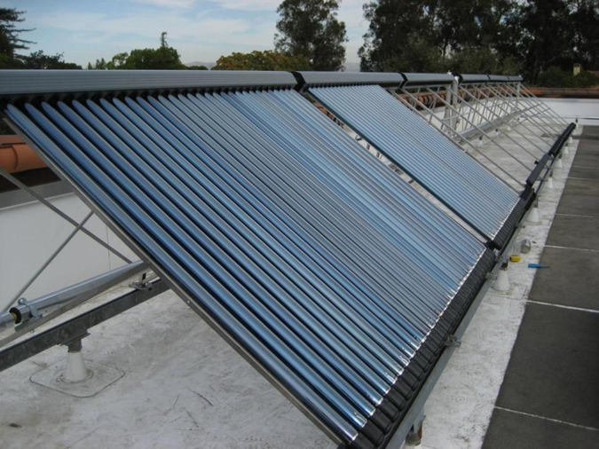
Solar Energy utilization at IIT Roorkee
Sensors developed by Students Using SCADA
Solar Steam Cooking: LPG savings of 5000 cylinders per year
Solar power: Capacity 1.819 MWp
Solar Water Heating Systems: Capacity 3.4 Lakh Litres per day

Slide 13
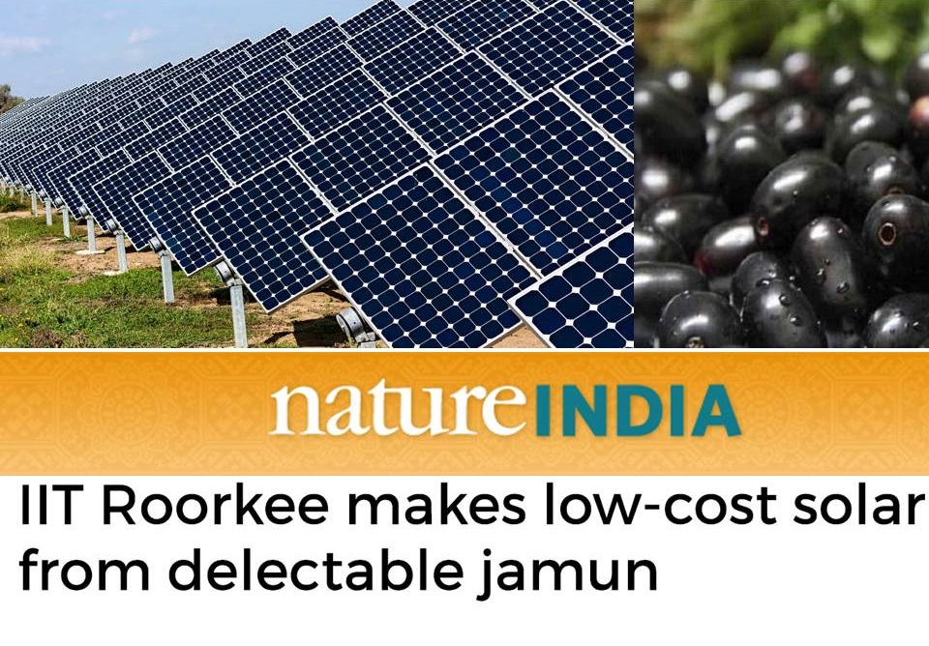
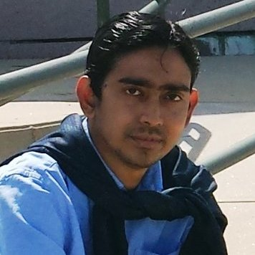
Novel Solar Cell device innovation at IIT Roorkee
Innovator: Prof. Soumitra Satapathi and his group at the Physics department

Slide 14
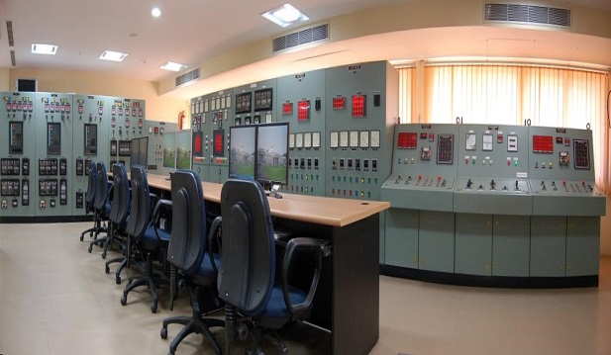
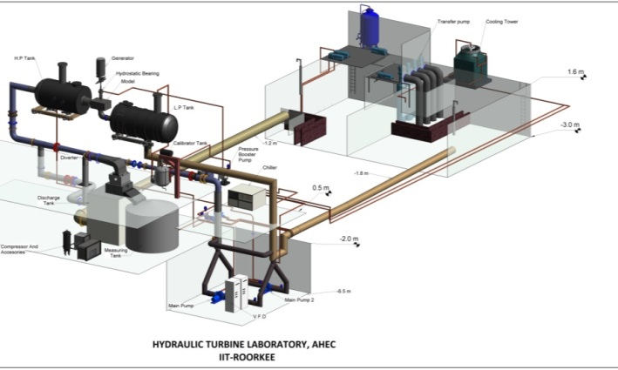
Real-Time Digital Simulator (RTDS) for Small Hydropower Plant
Hydro-energy
RTDS at Alternate Hydro Energy Centre
IIT Roorkee
Establishment Of Hydraulic Turbine Laboratory
First independent facility in the region
Head 15-60 m and discharge 1000 lps
Building 15 x 24 m height +13.5 to – 6.5 m
Water storage 600 cubic m

Slide 15
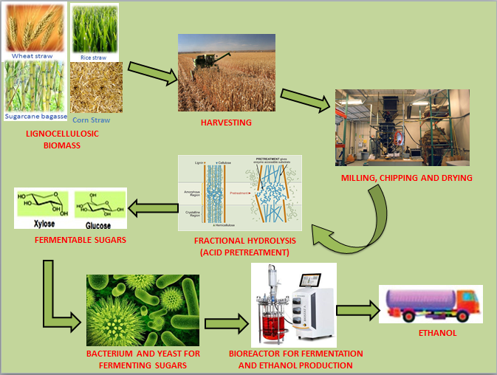
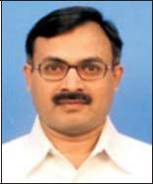
Development of large scale bioethanol production technology from lignocellulosic biomass for small and micro enterprise venture
Bio Fuel
Project taken up by Prof. Sanjoy Ghosh, Biotechnology Department,
Under Uchchatar Avishkar Yojana (Industry-Academia program)

Slide 16
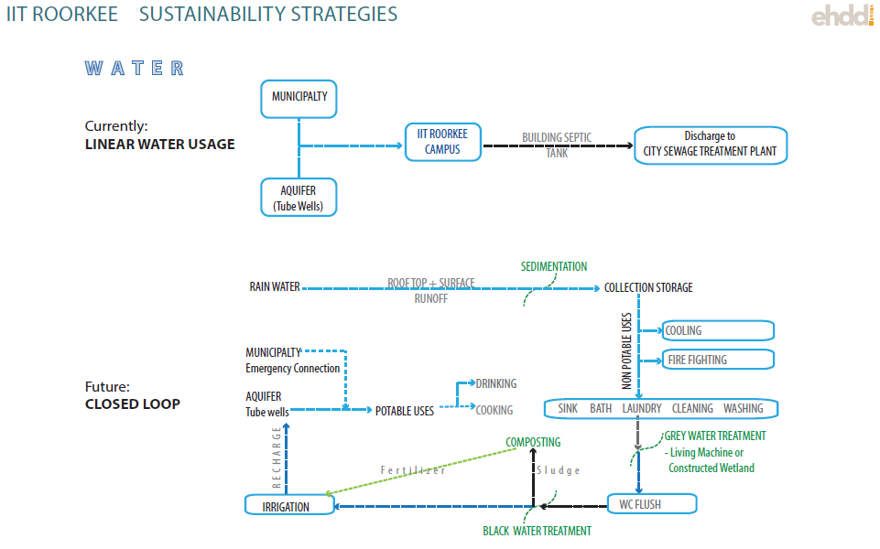
Research on Sustainable Technology
IIT Roorkee – where Sustainability is a core belief
Scaling at Local level, staging impact at Regional level and finally at National level

Slide 17
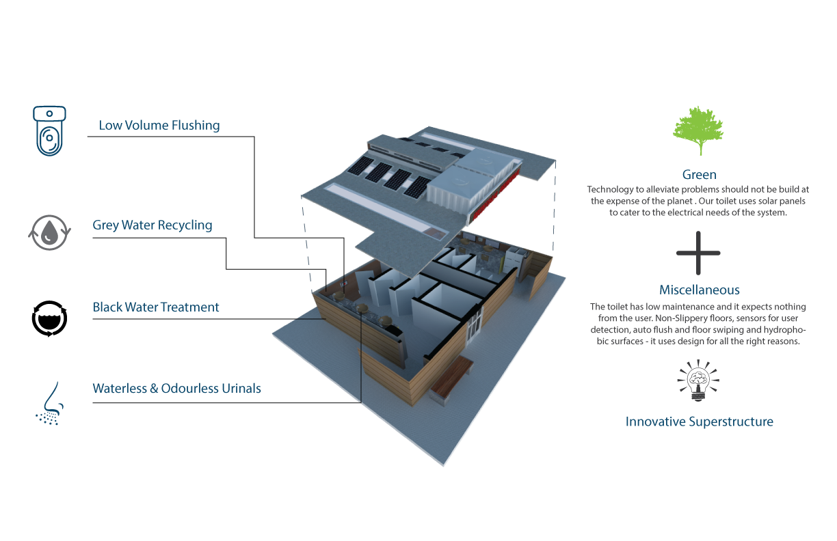
Sustainable Eco-toilets
Sustainable Eco-toilets are being developed by IIT Roorkee in collaboration with an NGO, Sukriti Social Foundation. Such toilets will be installed in the schools of Beladi and Meerpur villages adopted by IIT Roorkee under Unnat Bharat Abhiyan.

Slide 18
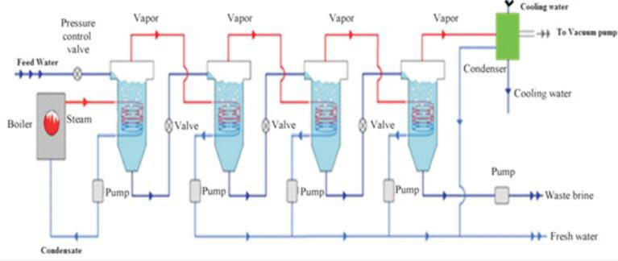
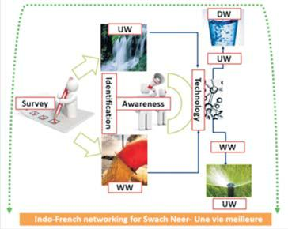
Solar Energy Assisted Multi-effect Distillation System to Produce Drinking Water in India from Contaminated Water
Swachh Neer - Une vie Meilleure: Combating water issues through Indo-French networking

Slide 19
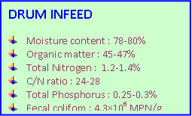
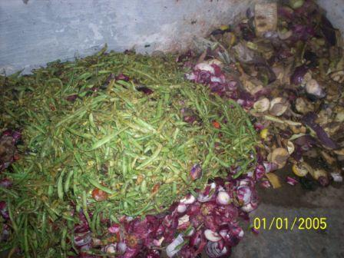
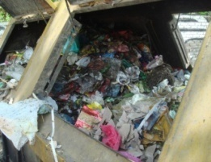
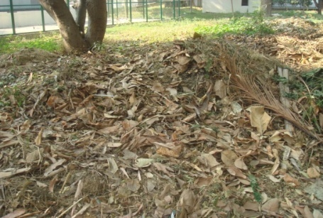
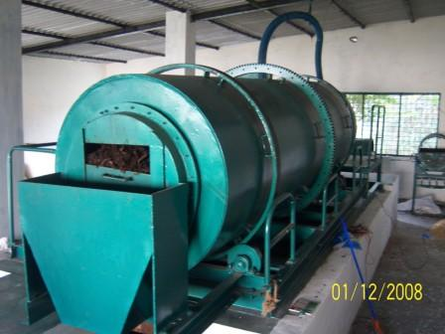
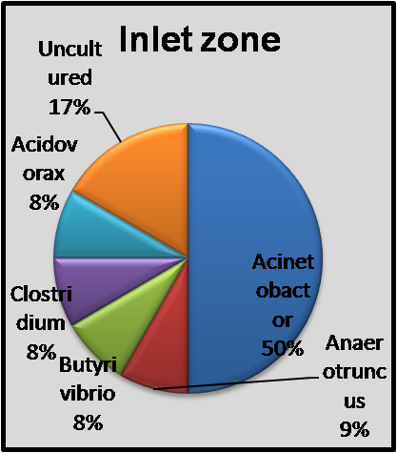
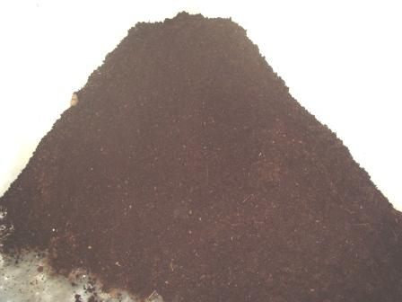
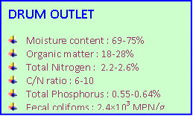
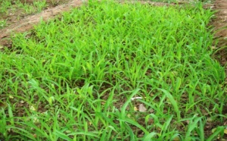
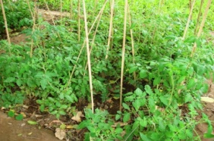
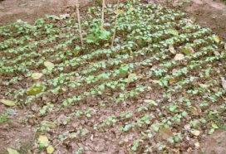
Decentralized Solid Waste Management :
High Rate Rotary Drum Composting; DST Project

Slide 20
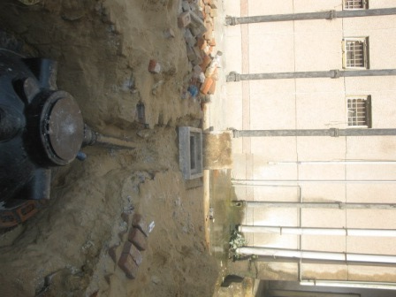
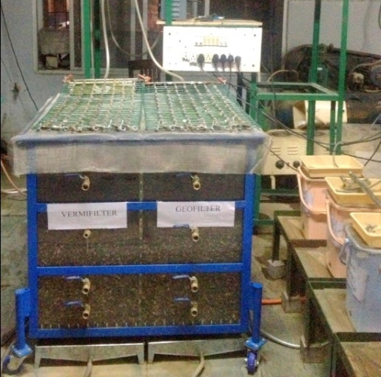
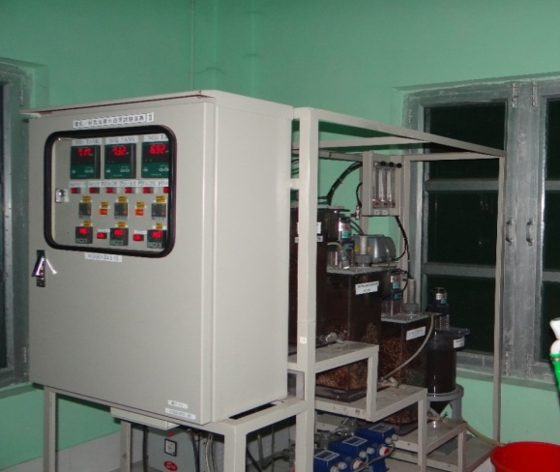
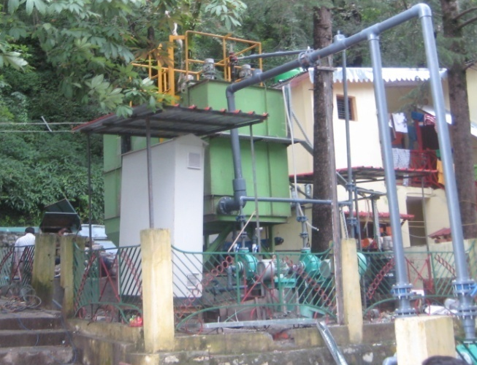
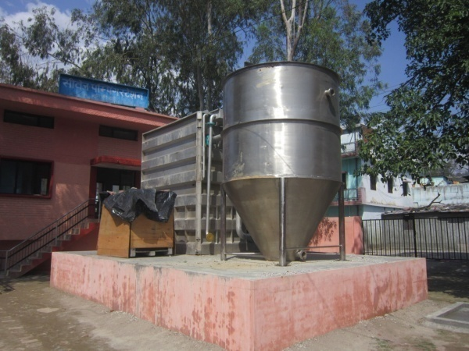
RECENT PROJECTS
Advanced on-site Wastewater Treatment System- MDWSS, Govt. of India
Vermifiltration for Sewage Treatment – DST, Govt. of India
Low Temperature Nitrogen Removal PVA Gel based MBBR, Kuraray Japan
Advanced Decentralized Wastewater Treatment & Reuse System- Indo-EU Project, DST
CSO Treatment by Ballasted Flocculation- Indo-EU Project, DST

Slide 21
Dr. A. A. Kazmi
Department of Civil Engineering
IIT Roorkee
Email: kazmifce@iitr.ernet.in
Tel: 91-9837262698
Research Interests:
Advanced Wastewater Treatment & Reuse
Solid Waste Management
High rate composting of Solid Waste
Education
Year | Degree | University
1999 | Doctor of Engg. | University of Tokyo
1996 | Masters of Engg. | AIT Bangkok
1993 | B.Sc. Eng | AMU, Aligarh

Slide 22
PROPOSED MECHANISM for CETPs
CURRENT CETPs
Primary Treatment WITHOUT Coagulation/Flocculation
Primary Treatment WITH Coagulation/ Flocculation
Secondary Treatment(Biological Process)
Industrial Effluent
Ozonation
Secondary Treatment(Biological Process)
Activated Carbon Filter
Ozonation
Pressure Sand Filter
Disposal
Disposal
Other areas of current research:
Conjunction of AOPs and biofiltration to degrade
  natural organic matter (DBP precursors) and
  emerging contaminants in water treatment plants
Increased efficiency of system
Sustainable
  No toxic sludge generation
Ability to meet the needs of highly variable waste water quality
Degradation of micro pollutants and emerging contaminants
Dr. Bhanu P. Vellanki
Dept. of Civil Engineering
bhanufce@iitr.ac.in
Interested in:
Hazardous and industrial waste treatment
Anything under the sun ☺

Slide 23
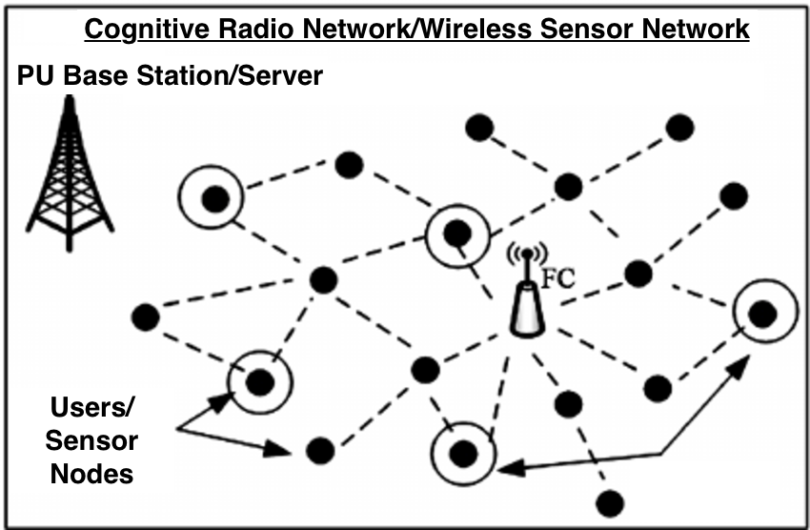
Wireless Communication
Area | Sub-Area
Wireless Sensor Network | Robust distributed data estimation Wireless sensor network layout Compressive sensing
Cognitive Radio Network | Missing data estimation Wideband spectrum sensing Cooperative spectrum sensing Cognitive radio engine
Research Project:
  Title: Computer-Aided Sign Language Teaching-Learning Tool for the Education of Hearing-Impaired Children in India
  Funding Agency: DST-TIDE (Amount: 31 Lakhs)
Relevant Publications:
  C. H. Hing, P. M. Pradhan, and J. R. Mitchell, “Approach for fast time-frequency analysis”, IET Signal Processing, 8(4):360–372, June 2014.
  C. H. Hing, P. M. Pradhan, and J. R. Mitchell, “Incorporating approximate rotational invariance into two-dimensional S-transform”, IET Image Processing. 9(7):535–544, July 2015.
  C. H. Hing, P. M. Pradhan, and J. R. Mitchell, “Texture analysis of images using a two-dimensional fast time-frequency transform”, Journal of Medical Imaging, SPIE, 2(2), 024504:1–10, May 2015.

Slide 24
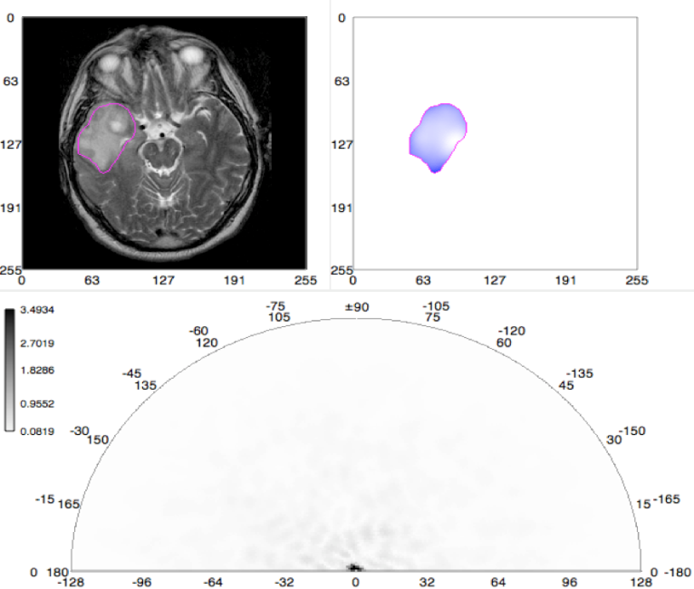
Signal/Image Processing
Area | Sub-Area
Time-Frequency Analysis | Rotational invariance Storage and computational complexity Pixel/ROI based texture analysis
Applications
Biomedical Signal/Image Processing | Parkinson’s disease diagnosis: Gait data Brain tumor diagnosis: MRI, CT images
Earth Sciences | Event detection
Dr. Pyari Mohan Pradhan
Assistant Professor
Dept. of Electronics & Communication Engineering
IIT Roorkee

Slide 25
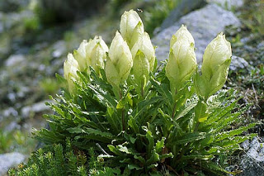
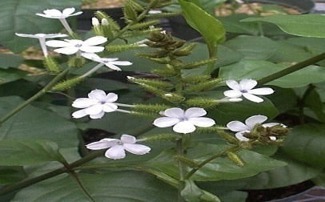
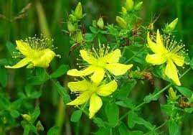
Affordable Plant Based Healthcare
  Medicinal Plants of Uttarakhand
  Functional genomics to improve fruit quality of Rosaceous fruits
Uttarakhand is a hot spot for many rare medicinal plants
Saussurea obvallata
State flower of Uttarakhand
Plumbago zeylanica
Hypericum perforatum
Ervatamia heyneana
Status: IIT Roorkee developed a semisyntheic plant-based anti-cancer drug. The drug is being tested on animals (xenograft) model in collaboration with University of Turku, Finland

Slide 26
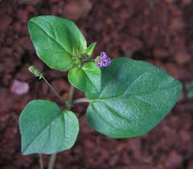
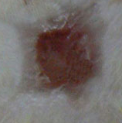
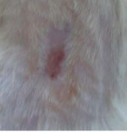
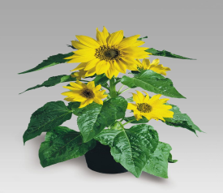
Plant metabolite and polysaccharide bio-matrix as an effective topical agents for wound sealing
P. Roy, D. Sircar and D. Lahiri
A special class of absorbable agent is plant based metabolites and polysaccharide bio-matrix which absorb water and low molecular compounds at the wound site and believed to be inducing coagulation through platelet plug formation by concentrating blood solids
B. diffusa
Angiogenesis in 9-days old chicken egg after treatment with HhC
Herb-to-Herb complex (Hhc)
Apple callus
Metabolomics
Rapid wound sealing and healing in animal model
H. annuus

Slide 27
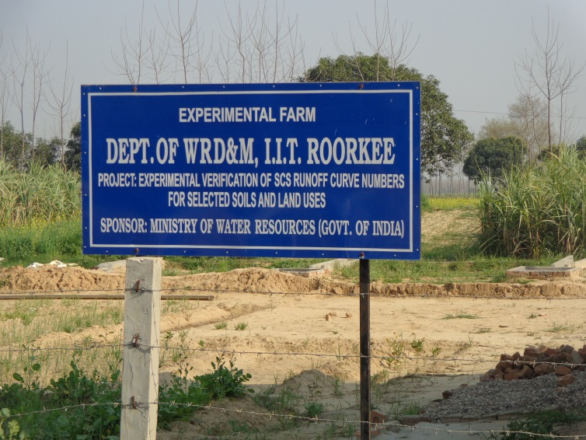
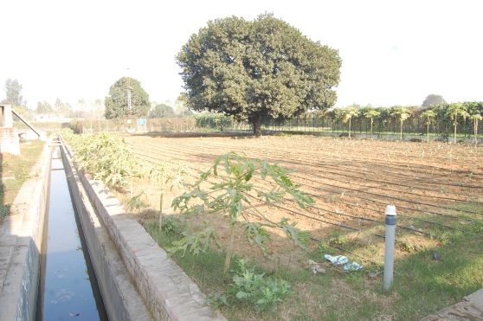
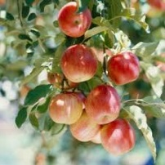
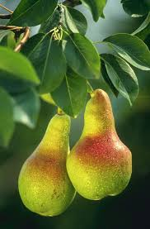


Thematic Group on Food Security
Experimental Farm at IITR
Mission
Objectives
Key Areas of Research
Molecular Breeding
Comparative Genomics
ROSOMICS
Improve in quality and
efficiency in production
of Rosaceous crop
Functional Genomics
Metabolomics
Fluxonomics
Functional genomics to improve fruit quality of Rosaceous fruits

Slide 28


Food Security: Detection of Urea Adulteration in Milk
Gold Nanoparticle based detection process
Patent Number 900/DEL/2014

Slide 29
MODELLING THE HIGH-SPEED TRAIN INDUCED DYNAMIC RESPONSE OF RAILWAY EMBANKMENT
A possibility to substitute resource demanding 3D problem by 2D model
Solution of dynamic problem for embankment cross-section
A possibility to optimize railway geometry and materials
Necessity for new experimental investigations

Slide 30

Load time shape

Slide 31
Thank You

