Slide 1
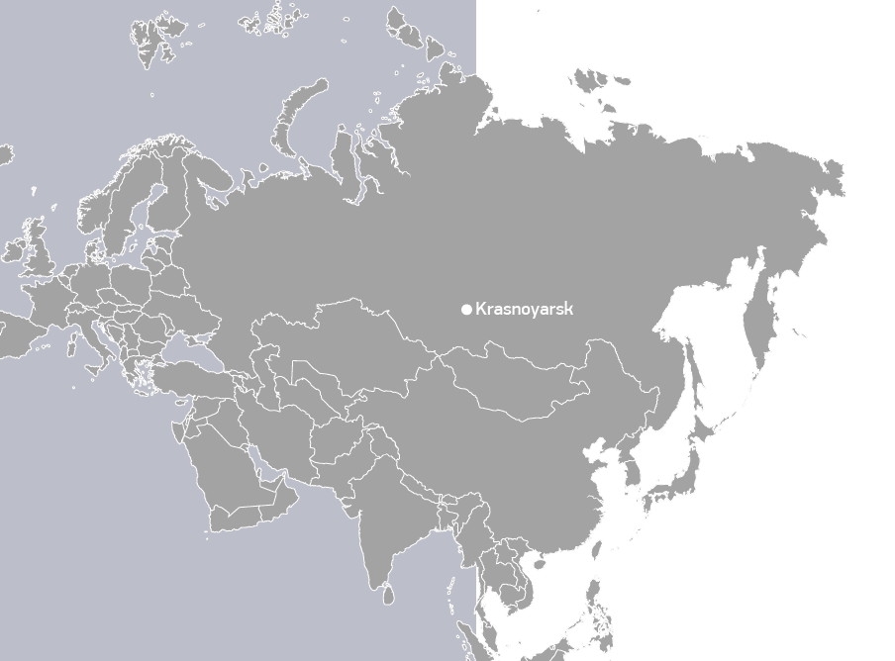

  www.sfu-kras.ru/en

Slide 2
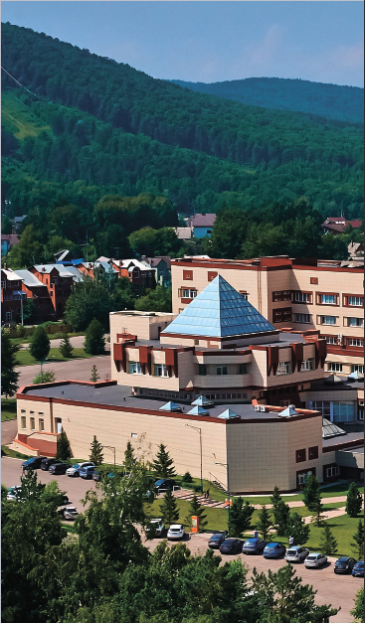

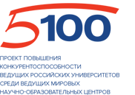




University mission
is to produce innovative solutions and provide comprehensive support to sustainable development of the unique territories and other global challenges of the XXI century as well as teaching qualified professionals for the needs of business and industry worldwide
Key research areas
Sustainable environmental management
Biology and biotechnology
«SibFU is a member of the national “Russian Academic Excellence Project” team. The University belongs to the top 20 of the country’s best universities»
Physics, chemistry and new materials
Radio technology, IT & digitalisation
Mining and geotechnology

Slide 3
Research profile
SibFU develops 5 strategic projects whose teams work in cutting-edge research trends
“Production of biochemicals, essential for humans, in aquatic ecosystems”
Project leader – Prof Michael Gladyshev, Chair of Department of Aquatic and Terrestrial Ecosystems, School of Fundamental Biology and Biotechnology.
“Development of the aluminum production technology based on low temperature electrolytes and inert anodes”
Project leader – Prof Petr Polyakov, School of Non-Ferrous Metals and Materials Science.
“New optical materials for novel applications in nano-and bio-photonics, solar energy conversion and nanomedicine”
Project leader – Dr Sergey Polyutov, head of Laboratory for Nonlinear Optics and Spectroscopy.
“Development of products from biopolymers for medical purposes (retention suture, wound covers, valves, etc.) and their clinical testing”
Project leader – Prof Tatyana Volova, PhD in Biology, Dr habil, Head of Biotechnology Chair.
“SibFU-BIOMED OPENLAB”
Project leader – Sr. D. José Mª. López-Cepero López-Cepero, Anatomía Patológica, Biología Celular, Histología, Historia de la Ciencia, Facultad
de Medicina Universidad de Cadiz.
Notes:
SibFU research activities and interests are focused on major global challenges of civilization in the XXI century: climate change (causes and consequences), impact of human activity on the environment, trends in biogeochemical cycles, improving the quality and expectancy of human life, ecologically-friendly and efficient technologies of mining and processing of natural resources, digitalisation and virtualisation of the environment.

Slide 4
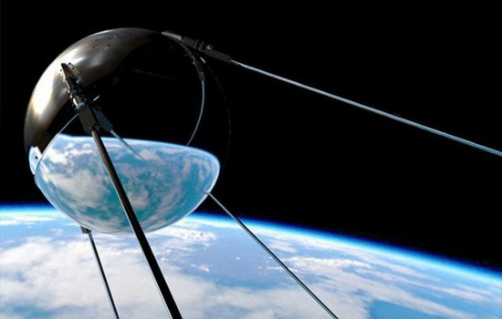


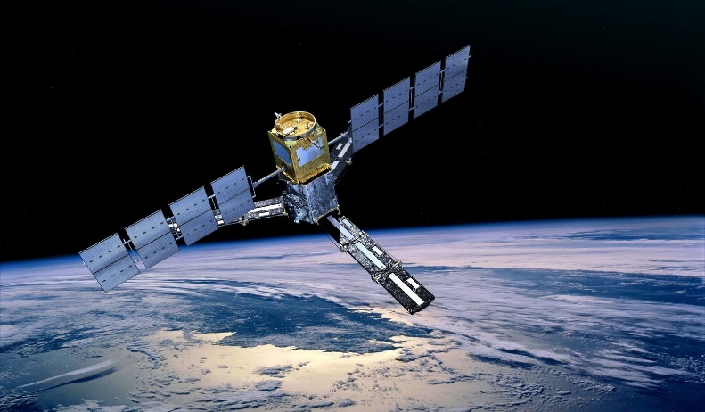
Scientific Schools
Integral methods in complex analysis and algebraic geometry
Krasnoyarsk Scientific School carrying out the multidimensional complex analyses was formed in 1965. During the years of the school formation the basic principles of the theory of integral representations and deductions have integrated methods were linked with algebraic and differential equations.
Dendroclimate and dendroecological monitoring of Northern Eurasia forests
expanding the existing network of dendroclimate monitoring stations in Northern Eurasia region and improving the methods of estimating the influence of climatic and non-climatic nature factors on the trees growth;
using the indicative possibilities of tree rings for getting knowledge about the carbon exchange between vegetation and atmosphere.
Environmental biophysics
Among the first academic scientific schools that were created in Krasnoyarsk and received the world recognition, the School of Environmental Biophysics was founded by the research of Professor Terskova and Professor Gitelzon, Acting member of the Russian Academy of Sciences. Subsequently it was developed by I. I. Gitelzon into modern school of Biophysics and Biotechnology of supraorganism systems.
Radio navigation and radar systems and devices
Radio Engineering Scientific School was established in 1941.
It was originated by outstanding designers of radiotechnical systems: Member of the Russian Academy of Sciences A.A. Raspletin; Dr. of Technical Sciences, Professor G.F. Ignatiev; Dr. of Technical Sciences, Professor V. G. Taranenko; M. K. Chmykh
Notes:
Integral methods in complex analysis and algebraic geometry
Krasnoyarsk Scientific School carrying out the multidimensional complex analyses was formed in 1965 under the direction of L. A. Aizenberg and A. P. Yuzhakov; the first one directed the integral representations for holomorphic functions and the second was at the head of the theory of multidimensional residues mentioned in the works of E. Martinelli and J.-P. Leray.
During the years of the school formation the basic principles of the theory of integral representations and deductions have been established, integrated methods were linked with algebraic and differential equations. These studies are reflected in monographs by L. A. Aizenberg and A. P. Yuzhakov; A. K. Tsikh; A. M. Kytmanov; N. N. Tarkhanov; L. S. Maergoiz.
Fundamental results were drawn in complex convexity, which were subsequently used and expanded to the developed theory in the monographs of Scandinavian mathematicians L. Hörmander; M. Andersson, M. Passare and R. Sigursson. The stability problem of two-dimensional digital recursive filters was also solved.
Dendroclimate and dendroecological monitoring of Northern Eurasia forests
Goals and research focus:
expanding the existing network of dendroclimate monitoring stations in Northern Eurasia region and improving the methods of estimating the influence of climatic and non-climatic nature factors on the trees growth;
using the indicative possibilities of tree rings for getting knowledge about the carbon exchange between vegetation and atmosphere.
Environmental biophysics
Among the first academic scientific schools that were created in Krasnoyarsk and received the world recognition, the School of Environmental Biophysics was founded by the research of Professor Terskova and Professor Gitelzon, Acting member of the Russian Academy of Sciences. Subsequently it was developed by I. I. Gitelzon into modern school of Biophysics and Biotechnology of supraorganism systems.
Radio navigation and radar systems and devices
Radio Engineering Scientific School was established in 1941.
It was originated by outstanding designers of radiotechnical systems: Member of the Russian Academy of Sciences A.A. Raspletin; Dr. of Technical Sciences, Professor G.F. Ignatiev; Dr. of Technical Sciences, Professor V. G. Taranenko; M. K. Chmykh — one of the greatest specialists in the field of digital measurement equipment, the organizer of the Research Institute of Radio Engineering of the Krasnoyarsk State Technical University, Head. Chair of «Radio-technical systems»; Dr. of Technical Sciences, Professor G. Y. Shaidurov.

Slide 5


















SibFU Schools
School of
the Humanities
School of
Economics,
Management and Environmental Studies
School of
Physical
Education,
Sport and Tourism
School of
Space and
Information
Technology
School of
Mining,
Geology and Geotechnology
School of
Engineering and Construction
School of
Non-Ferrous
Metals and
Materials Science
School of
Petroleum and
Natural Gas
Engineering
School of
Education,
Psychology and
Sociology
School of
Engineering
Physics and
Radio Electronics
Polytechnic
School
School of
Philology and
Language
Communication
School of
Fundamental
Biology and
Biotechnology
School of
Mathematics
and
Computer Science
School of
Architecture
and Design
School of
Ecology and
Geography
School of
Military
Engineering
Law School

Slide 6

Staff
6 804
staff
3 450
faculty
426
Professors, Doctors of Science
64
international visiting faculty lectured at SibFU summer schools
82
international faculty have been employed at SibFU for 10 years

Slide 7
Students
30 630
Students
800
international students
65%
of students are non-regional residents
200
research projects supported by the University
96%
of graduates find their first job within one year after graduation

Slide 8
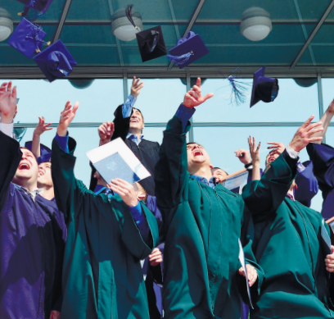
Teaching
184 undergraduate programmes: 63336 – 99808 RUR (930-1470 EUR) per semester
182 Master’s programmes: 69825 – 104472 RUR (1030-1540 EUR) per semester
4 double-degree programmes
16 international PhD programmes
8 Master programmes in English
8

Slide 9
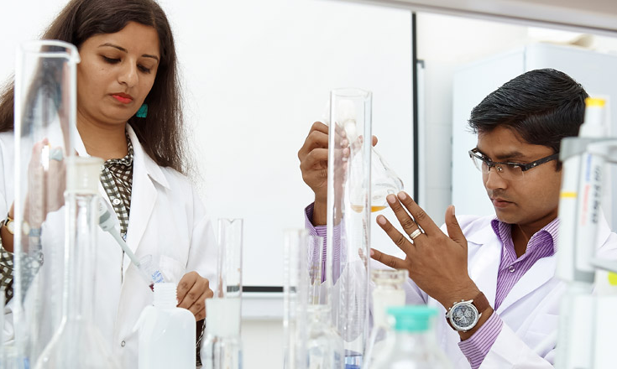
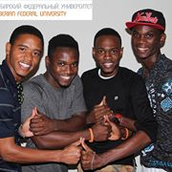

Master's Degree Programs
in English
Program Title
Duration
Applied Computing in Engineering and Science
2 years
Banking
2 years
Biological Engineering
2 years
Complex Analysis
2 years
Petroleum Chemistry
and Refining
2 years
Notes:
The enhancement of the quality of teaching and learning and preparing students to live and work is the key benefits and reasons for creating educational environments including the mobility of students and teachers.
SibFU increase an export of educational services and offers educational programs in English at SibFU are mostly focused on research activities. Educational process is based on unique successful experience of strategic partnership with the leading corporations (collaboration with industrial partners) and long lasting cross partnership of the University with the Russian Academy of Science.

Slide 10
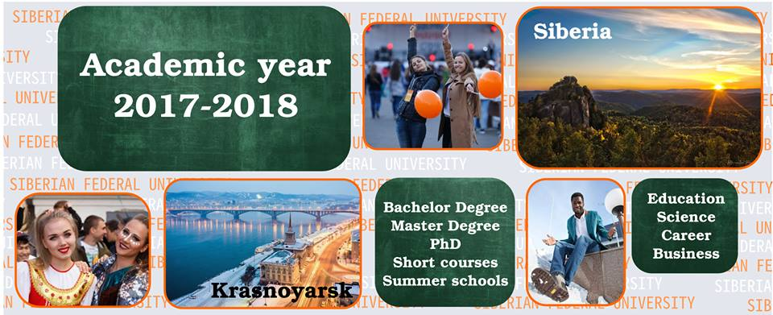
Specialized English-Taught International Semester Programs of Master’s Level
Program Title | Duration | Start date
Bioluminescent Biotechnologies | 18 weeks (30 ECTS credits) | February, 1
Complex Geometry | 18 weeks (30 ECTS credits) | October, 1
Embedded Microprocessor Systems | 18 weeks (30 ECTS credits) | October, 1
Integral Methods of Complex Analysis | 18 weeks (30 ECTS credits) | February, 1
Modeling of Processes of Oil Refining | 18 weeks (30 ECTS credits) | October, 1
Nonferrous Metallurgy | 18 weeks (30 ECTS credits) | February, 1
Technologies of Hydrocarbons Processing | 18 weeks (30 ECTS credits) | February, 1
Technologies of Life Support Systems and Risk management in the High North | 18 weeks (30 ECTS credits) | February, 1
Notes:
Integration of Education, Science and Innovation
The University is a winner of the Russian Government grants supporting research projects under the guidance of top-level scholars from Russia and all over the world. A wide variety of Research Laboratories and Centers give opportunities to do research for our faculty, students, postdoctoral fellows and visiting scientists. One of these research projects is being carried out in a laboratory of Bioluminescent Biotechnologies supervised by Nobel Laureate Professor Osamu Shimomura.

Slide 11
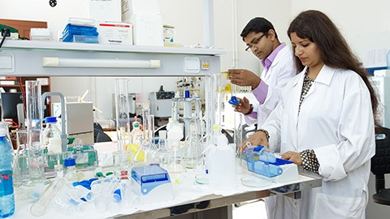
PhD programs
• Biophysics
• Metal Forming
• Metallurgy of Non-Ferrous Metals
• Multidimensional Complex Analysis
• Optics and Quantum Chemistry
• Urban Design and Planning
• Siberian Arctic Studies
• Ecology
• Hydrobiology
• Archeology
• Mechanics of Liquids, gas and plasma
• Paleogeography
• Environmental and Resource Economics
• Electrotechnology in metallurgy
Notes:
PhD and Posrdoc SibFU

Slide 12

Rankings
Siberian Federal University has always found itself in the country’s TOP 20 universities. Academic experts refer to such universities as ‘sustainable academic elite’ which serves as a testimony of a balanced managerial policy aimed at steady development and forward movement.
QS STARS 4 stars
QS BRICS 151-200
QS EECA 111-120
THE 800+
THE Europe top-400
THE BRICS 250-300
RankPRO 452
U-Multirank 7-8 position
ARES А+ 9 position
RAEX 16 position
Interfax 16

Slide 13
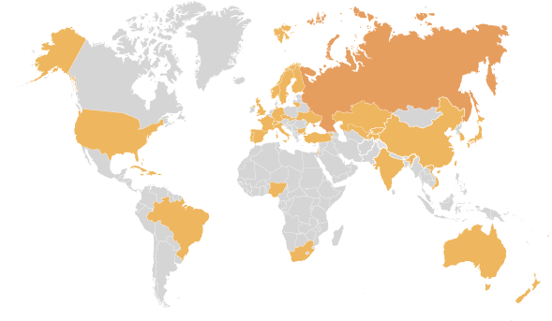





Partners
International projects with:
KTH Royal Institute of Technology
Technology Development in Biophotonics and Spectroscopy, Artificial Photosynthesis
Universidade Aberta, Portugal
Improving the quality of education for creative industries in Russia: developing a new Master’s programme meeting the EU standards
University of Mannheim, Germany
Technological exchange in post-Soviet economies of Ukraine and Russian compared to East Germany and Poland
University of Bologna, Italy
Life-long learning in developing multicultural approach in education and tolerance in Russia
Sweden
Norway
Finland
Ukraine
Denmark
Uzbekistan
Japan
Croatia
Armenia
Kazakhstan
USA
UK
Austria
Belarus
Check Republic
Mongolia
Tajikistan
France
Bulgaria
Kyrgyz Republic
South Korea
Germany
Israel
Turkey
China
Lithuania
Italy
Taiwan
Slovakia
Spain
Tailand
Switzerland
India
Singapore
Vietnam
Australia
New Zealand
Notes:
We have partnerships with 220 partner universities and organizations in 35 countries
Besides, we are a member of the international associations and consortia such as ….. And Association of Russian and Indian Universities

Slide 14
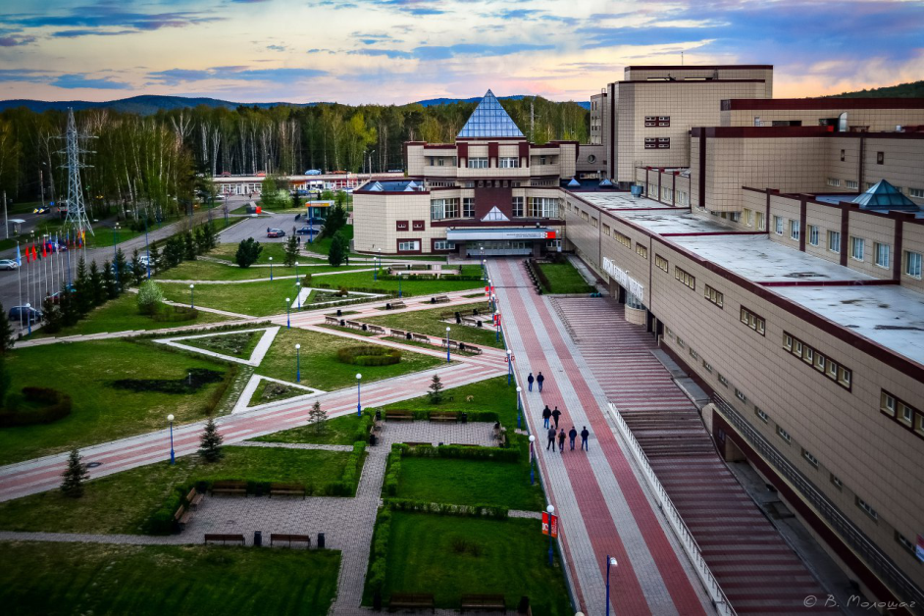
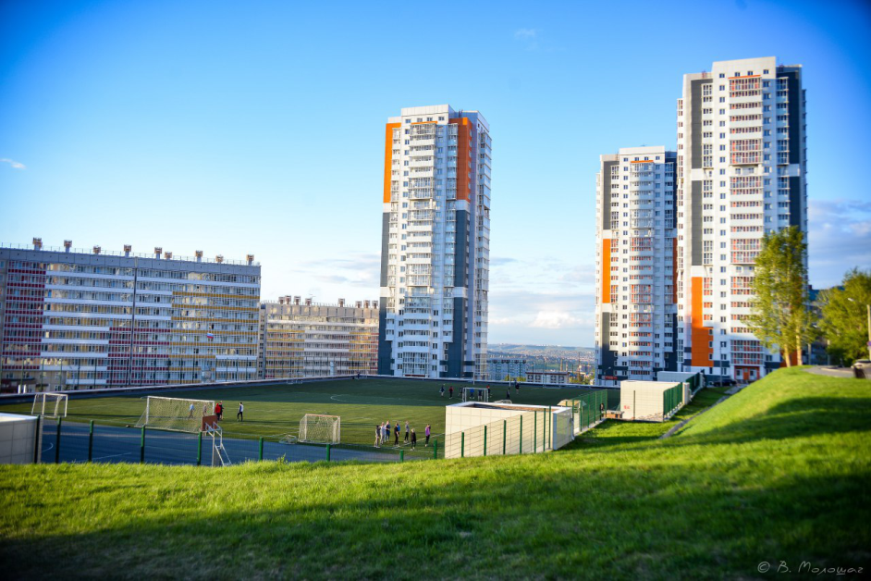
Comfortable Campus
The University campus is a big space, it includes alongside with teaching halls dormitories which offer higher-level comfort rooms for visiting professors, a library, exhibition galleries, sport facilities, gyms, shops, cafes, coffee shops and gift shops. A well-planned and friendly-designed campus infrastructure with plenty of places satisfying basic needs makes it a pleasurable and safe place to stay on. Landscape design of the campus, its mini-parks and green open spaces, pedestrian walkways have become a part of not only University hospitality tours but are favoured by the city residents and their guests.
2
Swimming
pools
32
dormitories
10
Students canteens
and buffets
10
Sport facilities
3
Music studio
24
Teaching
facilities
4
Dance halls
30
Gyms
3
Skiing sites
4
Track and
field stadiums
Network of University
mini-markets under
“U” brand

Slide 15
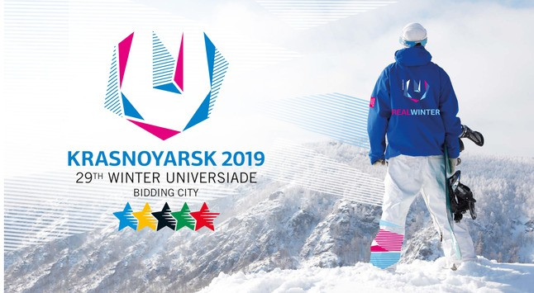
XXIX WINTER UNIVERSIADE 2019
The 29th World Winter Universiade 2019 will bring a lot of young athletes from all over the globe to Krasnoyarsk, a multi-ethnic place with unique Nature.
99800 m2
is the total floor
area of the Village
dormitories
4000
athletes is accommodating capacity of Athletes’ Village
1800
volunteers will be
accommodated
in Athletes’ Village
Notes:
The 29th World Winter Universiade 2019 will bring a lot of young athletes from all over the globe to Krasnoyarsk, a multi-ethnic place with unique Nature. The Athletes’ Village will be located on the University campus. The campus was approved for the
purpose by FISU (International University Sports Federation), which found it the most suitable place meeting the FISU high requirements of comfort and safety.

Slide 16

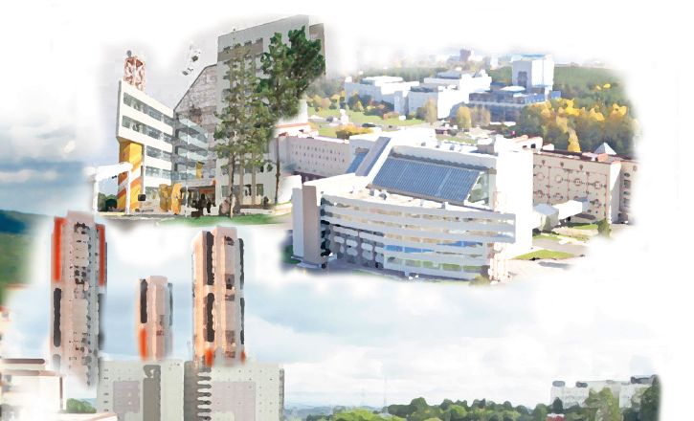
Thank you very much e-mail: vupirova@sfu-kras.ru

